Slide 1
Deep Learning for Conversational AI
Siliang Tang
siliang@zju.edu.cn

Slide 2
Goals
Give an overview of recent research trends in deep learning for conversational AI
Provide a detailed overview of (importance of) task-based dialogue systems Analyse most promising research avenues and stress their current limitations Discuss the importance of data requirements vs. algorithm choices
Present an industry-based perspective on current deep conversational AI Detect current “make it or break it” challenges in conversational AI

Slide 3

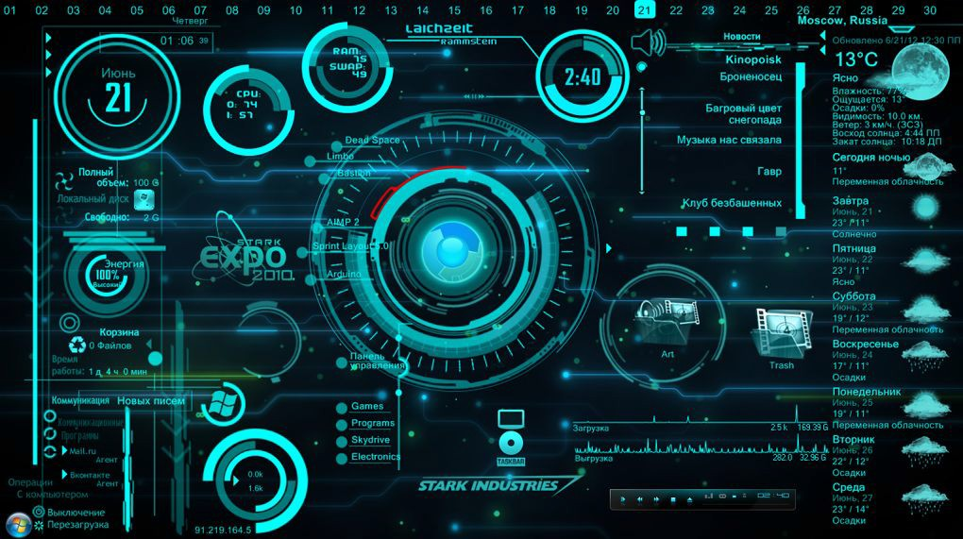
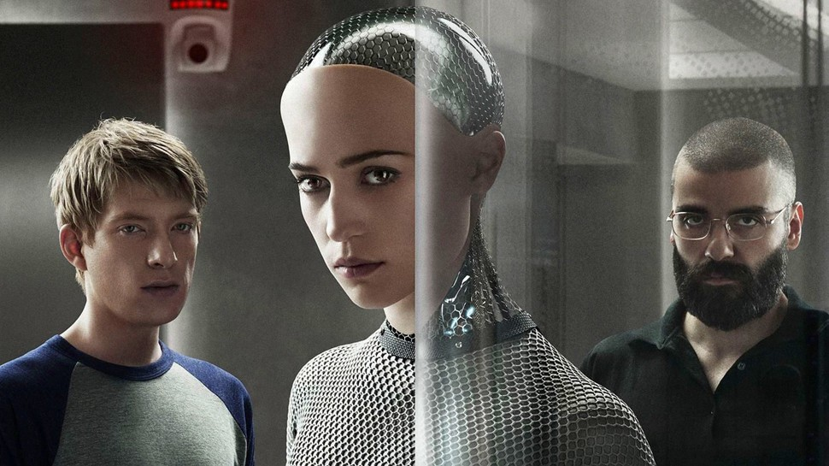

Conversational AI in Fiction

Slide 4
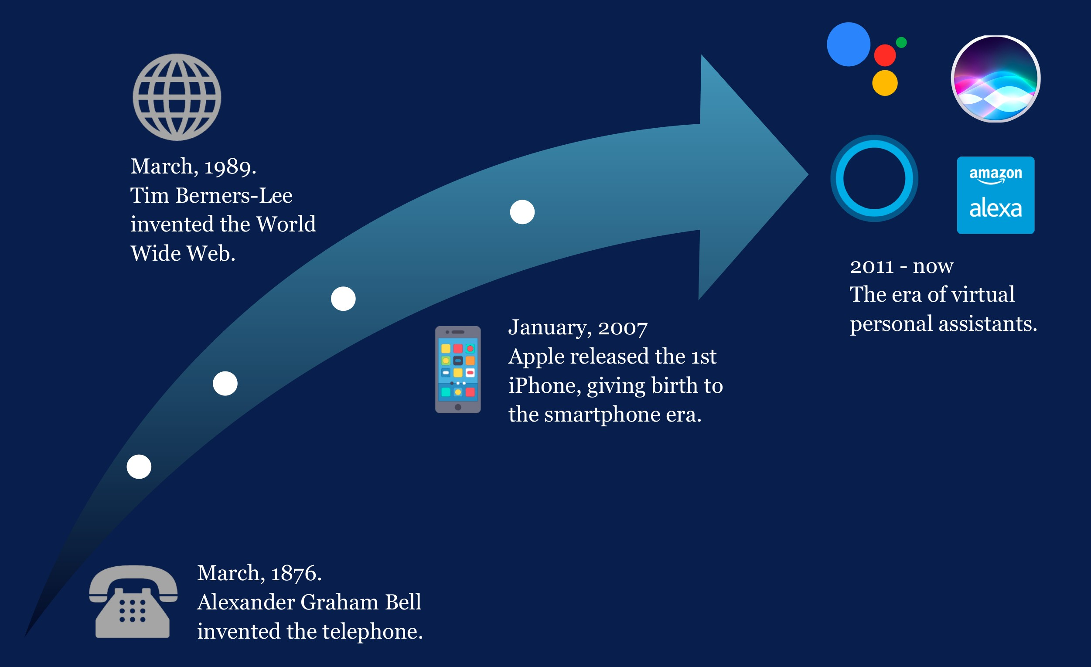
Virtual Assistants are the Next Platform

Slide 5
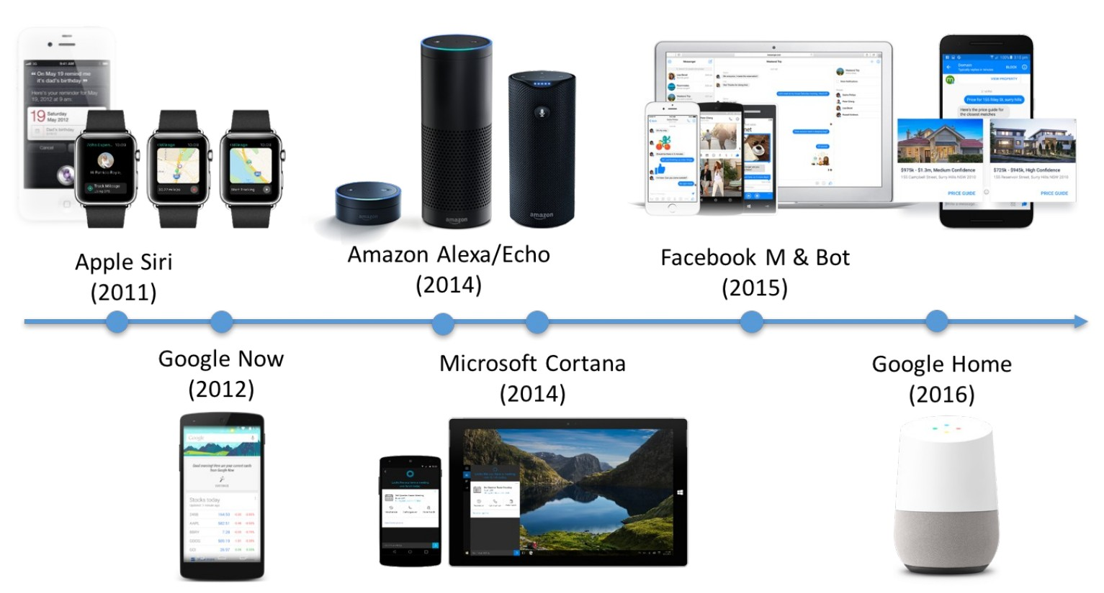
Virtual Assistants are the Next Platform
Voice and Language as the Command

Slide 6
Virtual Assistants are the Next Platform
The Amazon Echo is the top selling item on Amazon
20% of US homes already own a smart speaker
...and this number will quadruple in the next two years
53% of smart speaker owners bought their device last Christmas
Virtual assistants are becoming the main entry point for all actions and services available across all smart devices
Instead of different interfaces for smartphones, watches and homes, virtual assistants allow users to access them in the same way – using their voice

Slide 7
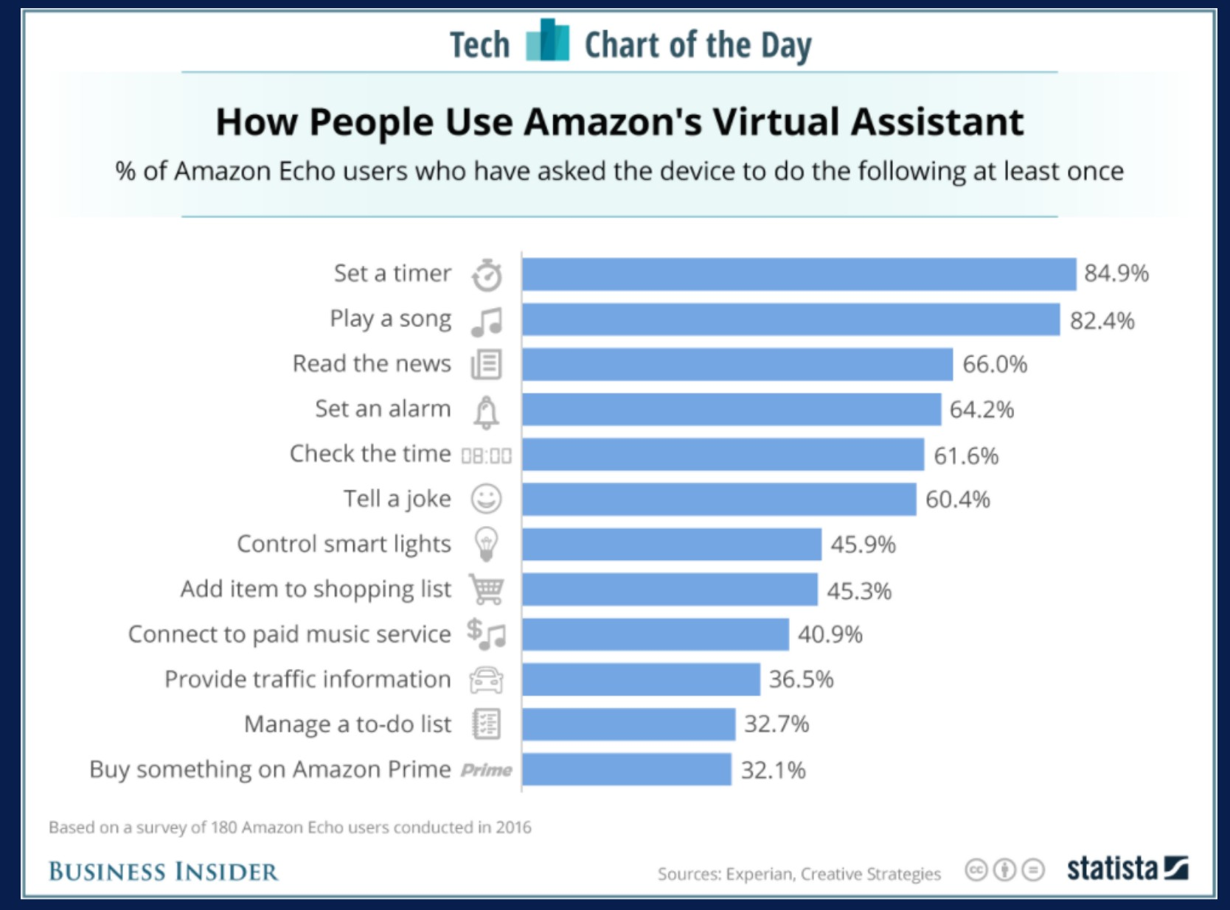
Conversational AI in 2018

Slide 8
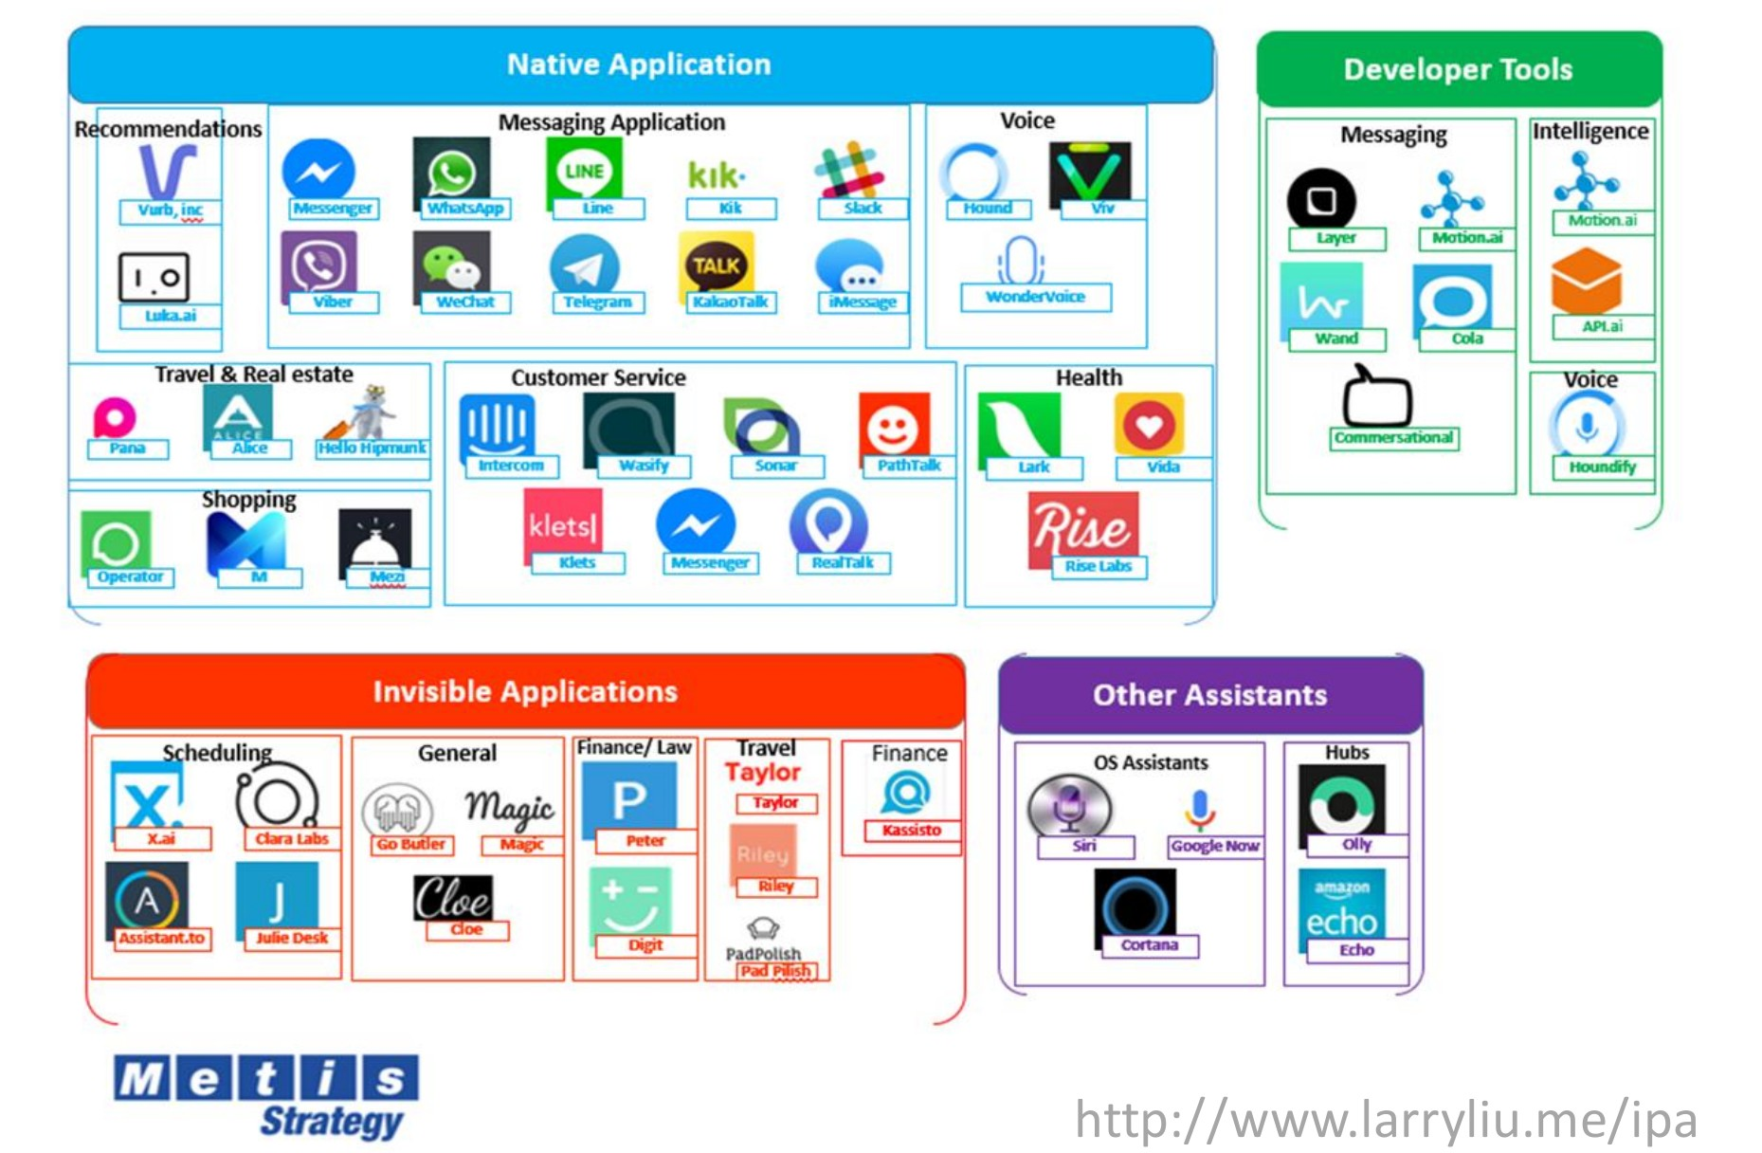
Conversational AI = Conversational UI?

Slide 9
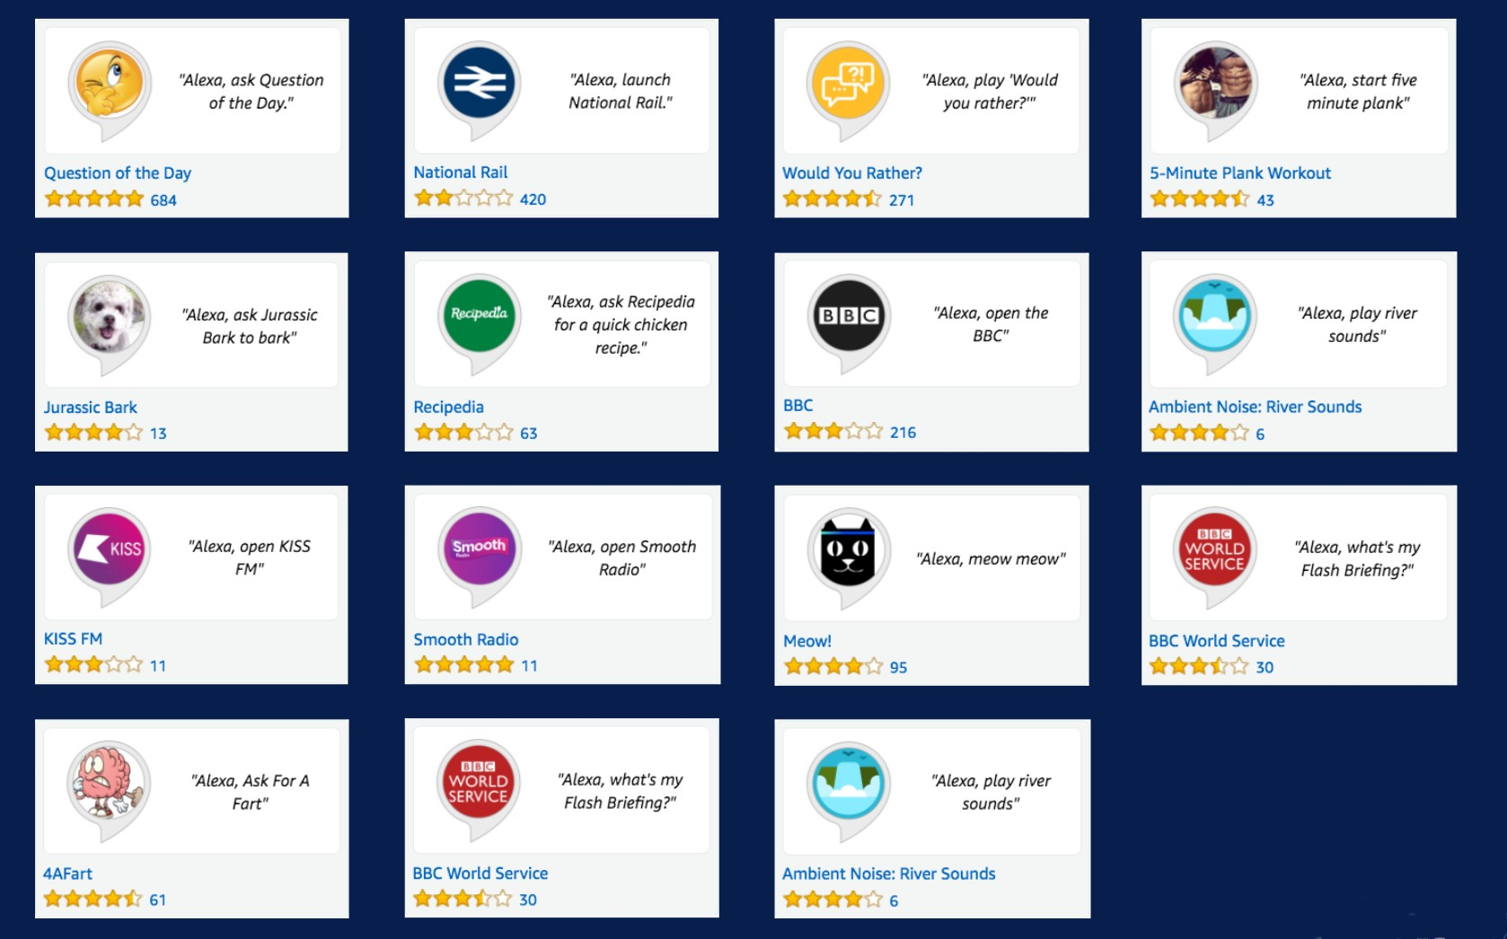
Conversational AI in 2018
Top Alexa skills are still simple single-turn commands

Slide 10
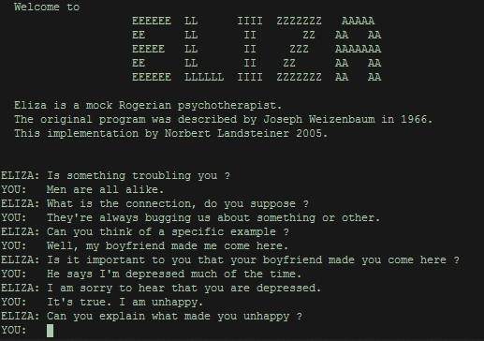
Conversational AI in 1966
Joseph Weizenbaum’s ELIZA (1966)
ELIZA: What is bothering you?
User: I feel sad all the time
ELIZA: Why do you feel sad all the time?
User: I don’t get along with my parents.
ELIZA: Tell me about your parents.
https://en.wikipedia.org/wiki/ELIZA

Slide 11
Conversational AI in 2018
Applications
Bookings: restaurants, hotels, flights, train tickets, ...
E-commerce: from search to payment
Accounting and Finance: from organizing records to cryptocurrency trade
Healthcare: from updating the EMRs to psychotherapy
Marketing: e-mail marketing, social media search, ...
Daily life: setting your alarm clock, reminding about meetings, ...

Slide 12
Conversational AI in 2018
Google Duplex: demo released in May 2018
“The technology is directed towards completing specific tasks, such as scheduling certain types of appointments. For such tasks, the system makes the conversational experience as natural as possible, allowing people to speak normally, like they would to another person, without having to adapt to a machine...”
“One of the key research insights was to constrain Duplex to closed domains, which are narrow enough to explore extensively. Duplex can only carry out natural conversations after being deeply trained in such domains. It cannot carry out general conversations.”
Source: https://ai.googleblog.com/2018/05/duplex-ai-system-for-natural-conversation.html

Slide 13
Challenges and Problems
How to deal with variability and flexibility of language?
What about other languages: multilinguality?
How to build robust and multi-domain systems?
How to get high-quality in-domain data?
How to build meaning representation?
How to integrate commonsense and world knowledge?
Do we want very specialized or more adaptable systems?

Slide 14
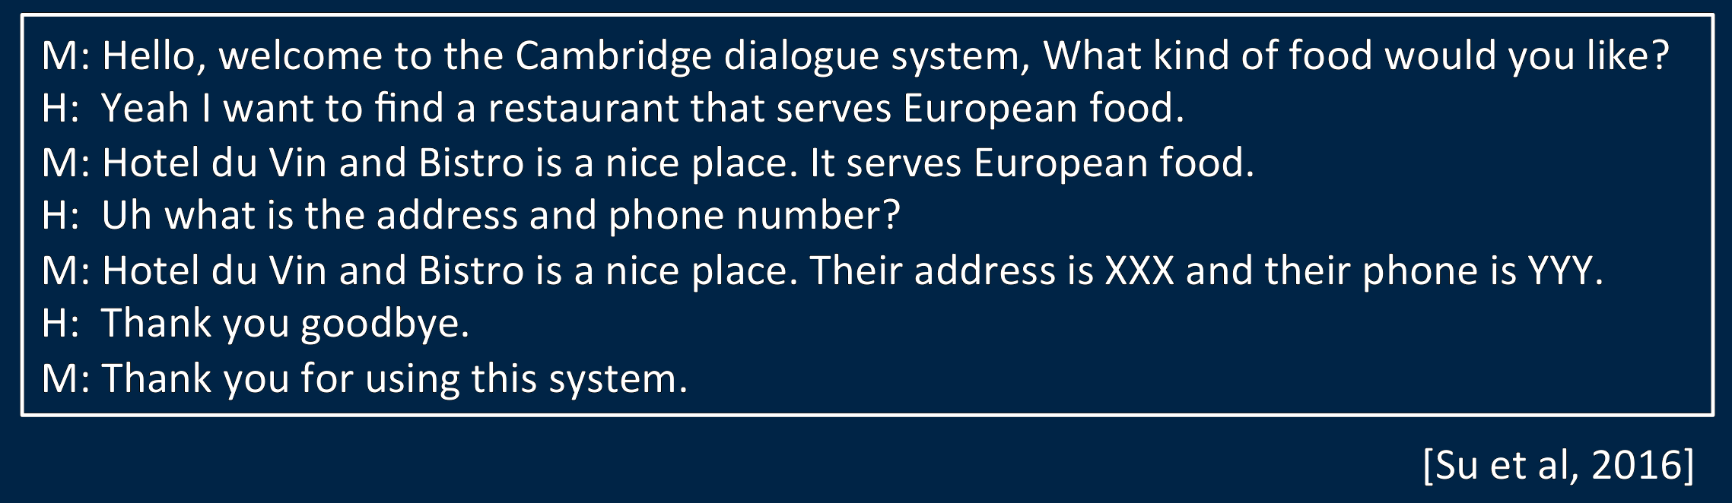
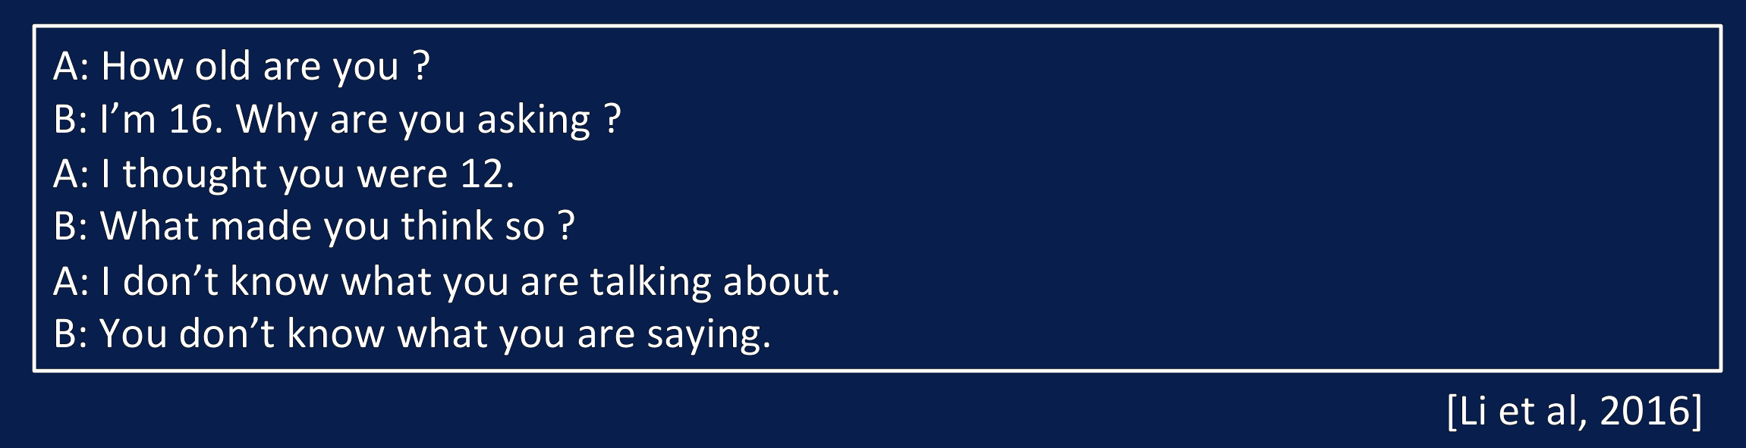
The Two Paradigms: Task-Oriented vs Chatbots

Slide 15
The Two Paradigms
Task-Oriented Dialogue Systems
Goal-oriented
Require precise understanding, it is hard to collect data
Modular, highly hand-crafted, restricted ability, but meaningful/useful systems
Chat-Based Conversational Agents
Chit-chat (no goal)
Large amounts of data (but probably not helpful so much)
End-to-end, highly data-driven, but meaningless/inappropriate responses, unreliable systems

Slide 16
Dialogue as a Partially Observable Markov Decision Process (POMDP)
[Williams and Young, 2007; Young, 2010; Young et al., 2013]
Data
Noisy observations
Propagating uncertainty and modelling the belief state
Model
Partially observable Markov decision process
Predictions
Optimal system actions in noisy environments

Slide 17
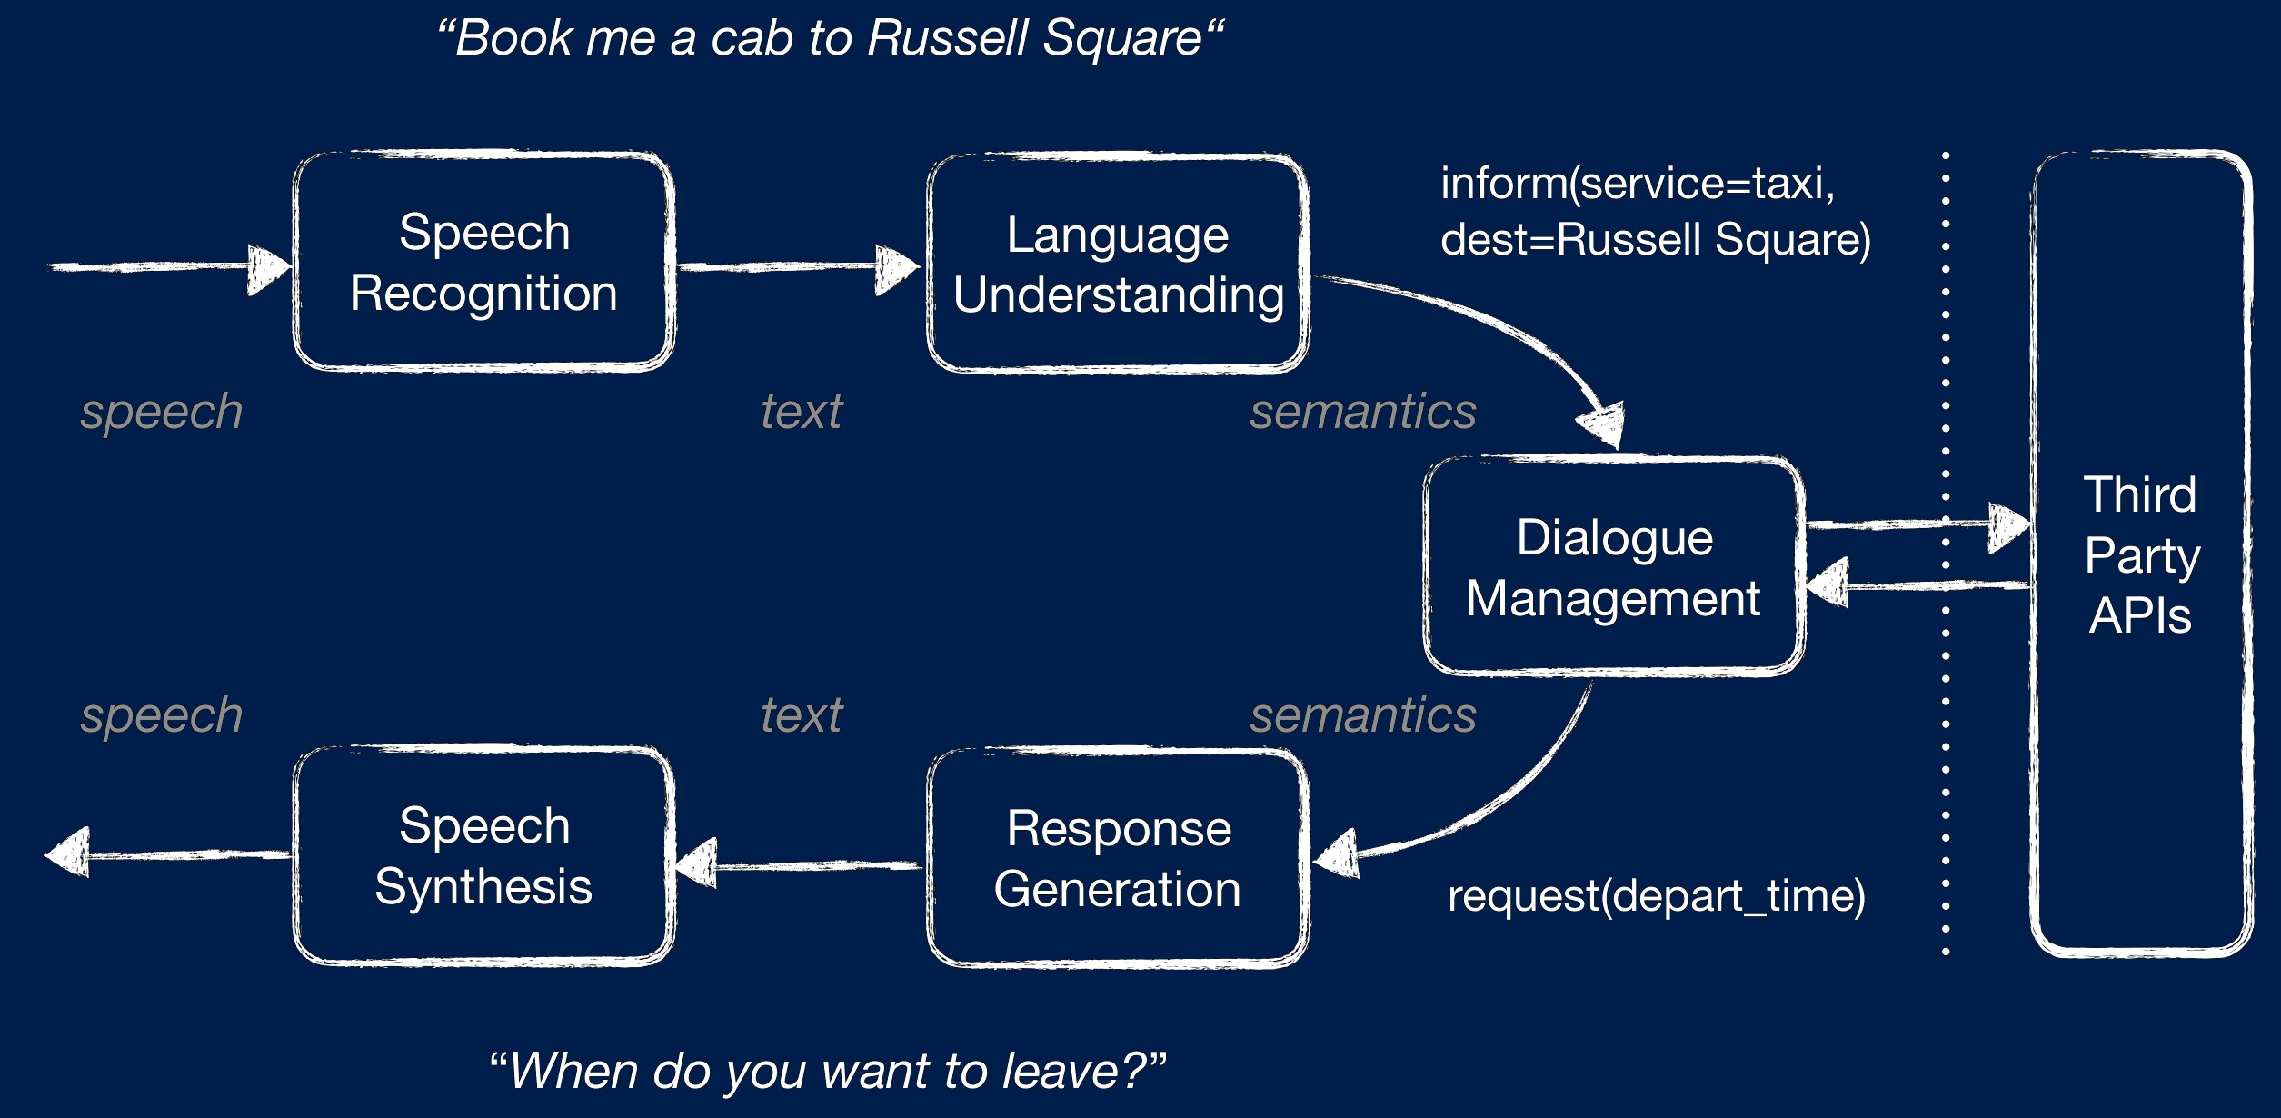
Task-Oriented Dialogue Systems

Slide 18
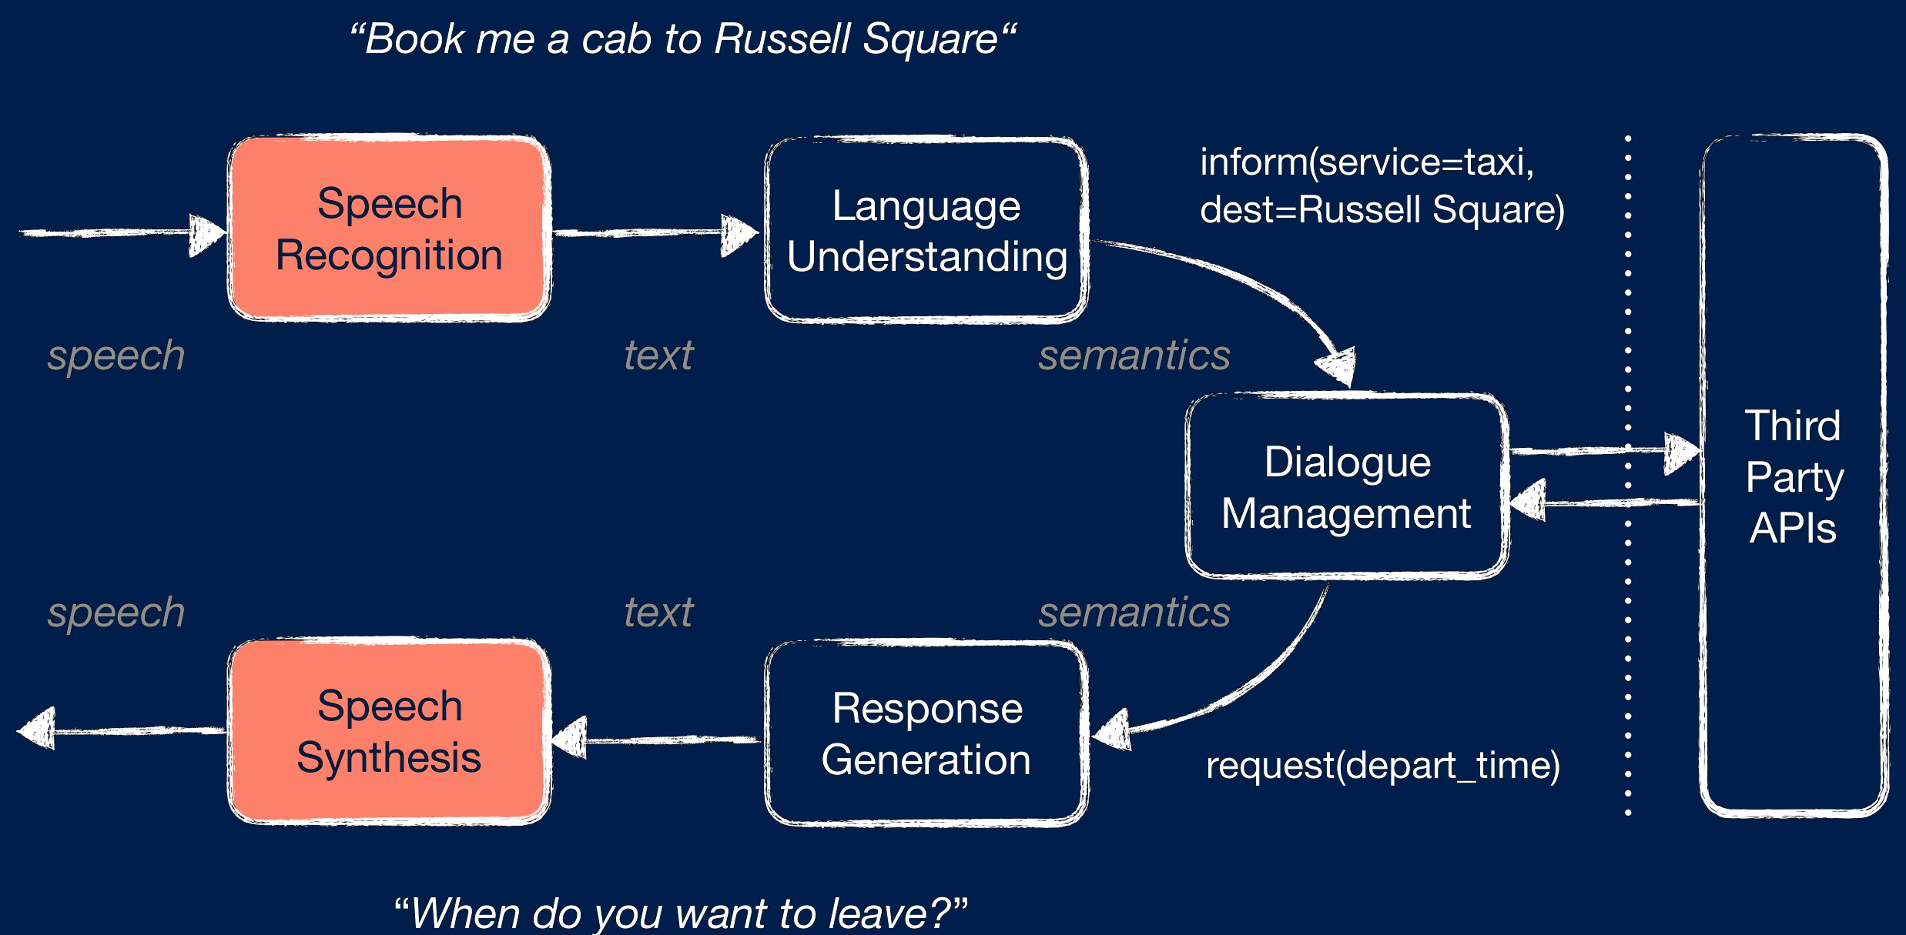
Task-Oriented Dialogue Systems

Slide 19
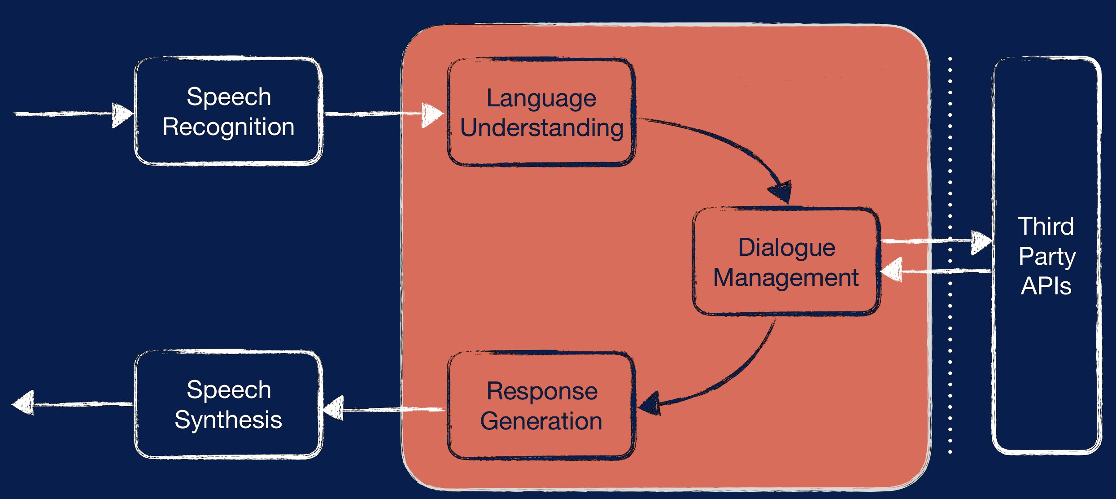
Task-Oriented Dialogue Systems

Slide 20
Natural Language Understanding

Slide 21
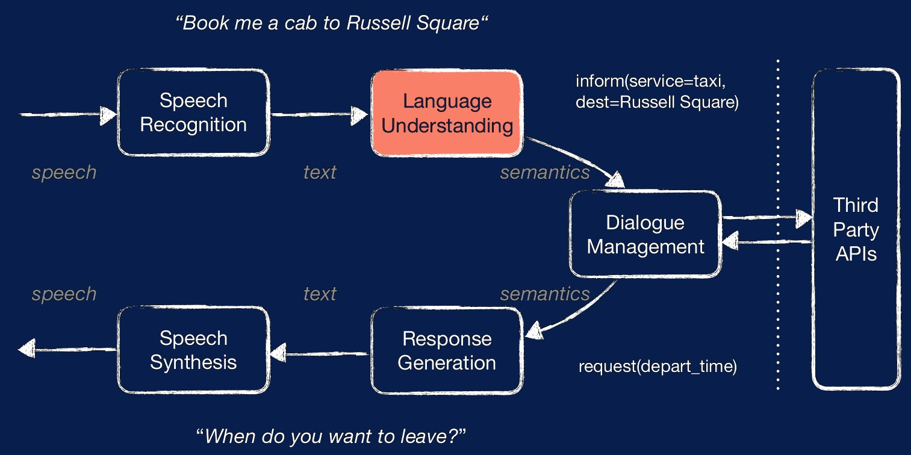
Natural Language Understanding

Slide 22
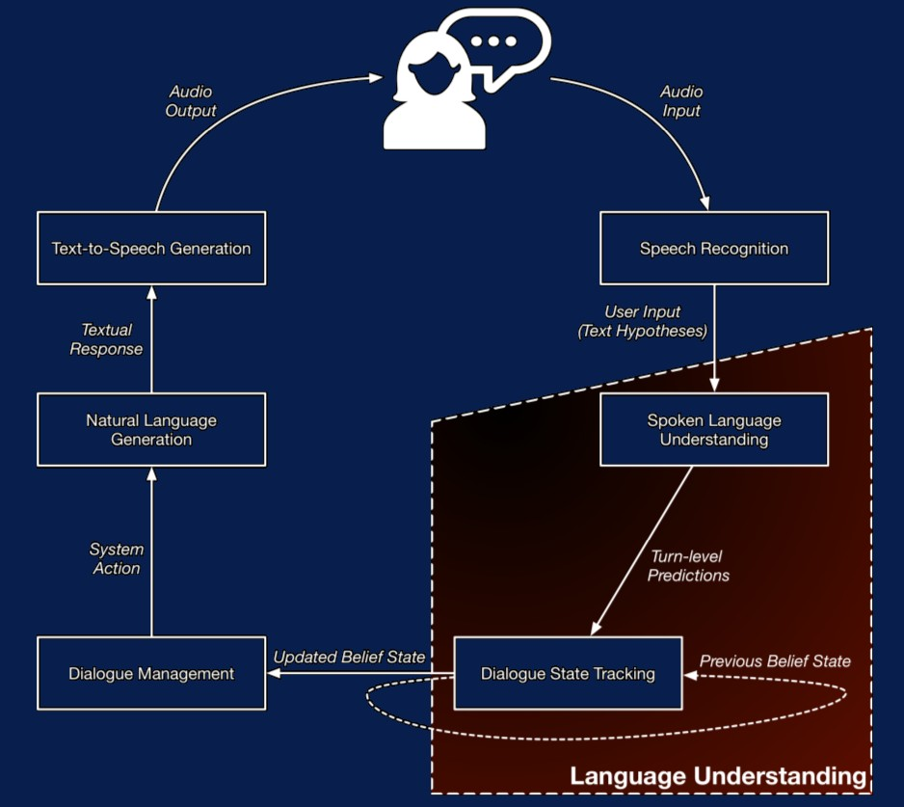
Language Understanding

Slide 23
Spoken Language Understanding
Three main components in the pipelined fashion
1. Domain Classification
2. Intent Classification
3. Slot Filling

Slide 24
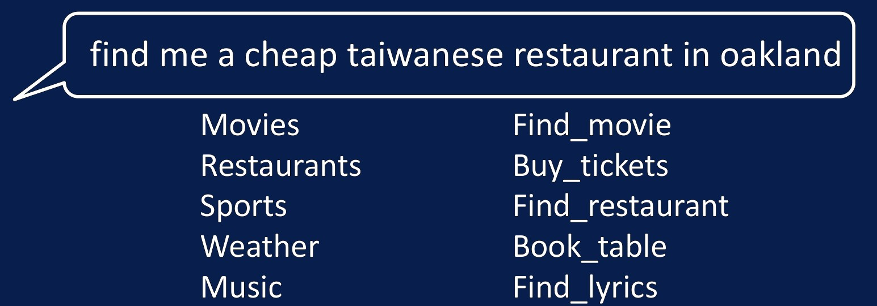
Dialogue Act Classification...
...also known as intent classification
Label each dialogue utterance with intent
Deep neural networks can be directly applied to this standard classification problem
[Sarikaya et al., 2011; Tur et al., 2012; Ravuri and Stolcke, 2015; Lee and Dernoncourt, 2016; Khanpour et al., 2016]

Slide 25
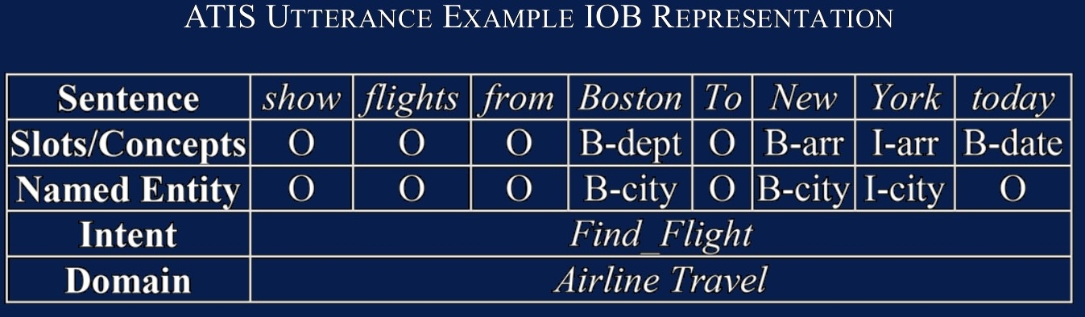
Language Understanding as Slot Filling
Sequence/Slot Tagging
Variations of RNN architectures have been used: LSTM-based models, BiLSTMs, other variations... [Mesnil et al., 2015]
More recently: (attention-based) encoder-decoder architectures instead of basic RNNs [Simmonet et al., 2015; Kurata et al., 2016]
Multi-task learning formulation: sharing across domains to increase robustness [Jaech et al., 2016; Tafforeau et al., 2016]

Slide 26
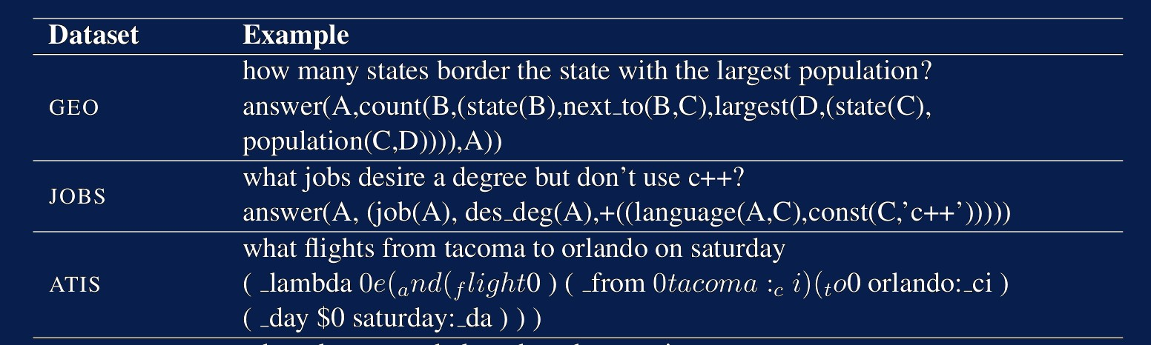
A Note on Semantic Parsing
SLU and DST resemble the task of semantic parsing
Converting natural language into computer-executable formal meaning representations for domain-specific applications
The dialogue act formalism is considerably simpler
Do we really need a full meaning representation of each sentence?
[Kate et al., 2010; Liu and Lane, 2016; Hakkani-Tur et al., 2016, Padmakumar et al., 2017, Ravichander et al., 2017]

Slide 27
Dialogue State Tracking

Slide 28
Language Understanding

Slide 29
Dialogue State Tracking Challenge (DSTC)
It is now Dialogue System Technology Challenge!
Challenge | Type | Domain | Data Provider | Main Theme
DSTC1 | Human- Machine | Bus Route | CMU | Evaluation Metrics
DSTC2 | Human- Machine | Restaurant | Cambridge | User Goal Changes
DSTC3 | Human- Machine | Tourist Info | Cambridge | Domain Adaptation
DSTC4 | Human- Human | Tourist Info | I2R | Human Conversation
DSTC5 | Human- Human | Tourist Info | I2R | Language Adaptation
DSTC6 | Human- Human | Restaurant, Twitter | Various | End-to-End Modeling
https://www.microsoft.com/en-us/research/event/dialog-state-tracking-challenge/

Slide 30
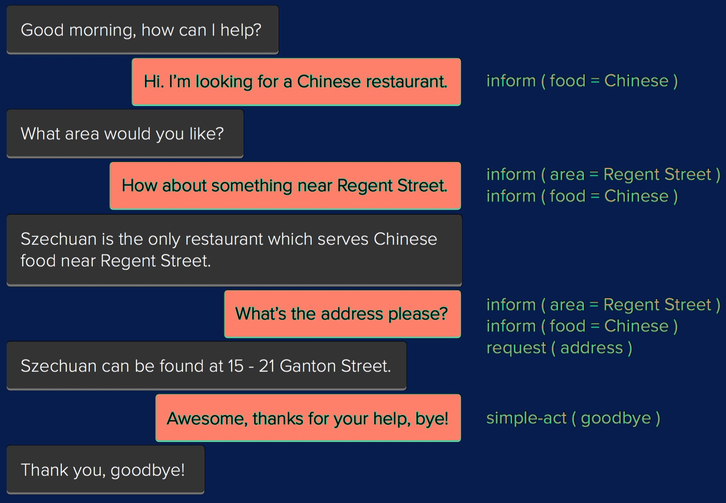

Domain Ontology
Domain Ontologies for Task-Oriented Dialogue
Task-oriented systems’ ontologies consist of a collection of slots s $∈$ S (i.e. food, price, etc.) and their slot values V_{s} (cheap, expensive, etc.).

Slide 31
Domain Ontology
Dialogue State Tracking Challenge 2
The belief state is a probability distribution over the possible dialogue states defined by the domain ontology. The downstream dialogue manager component uses the distribution to decide on the next system action.
DSTC2 Ontology: three Informable slots...
Area: North, East, South, West, Centre + dontcare
Price: Cheap, Moderate, Expensive + dontcare
Food: Indian, Chinese, Thai, Japanese, Greek, French + 84 others
...and seven (turn-level) Requestable slots...
Food, Area, Price, Address, Phone Number, Postcode

Slide 32
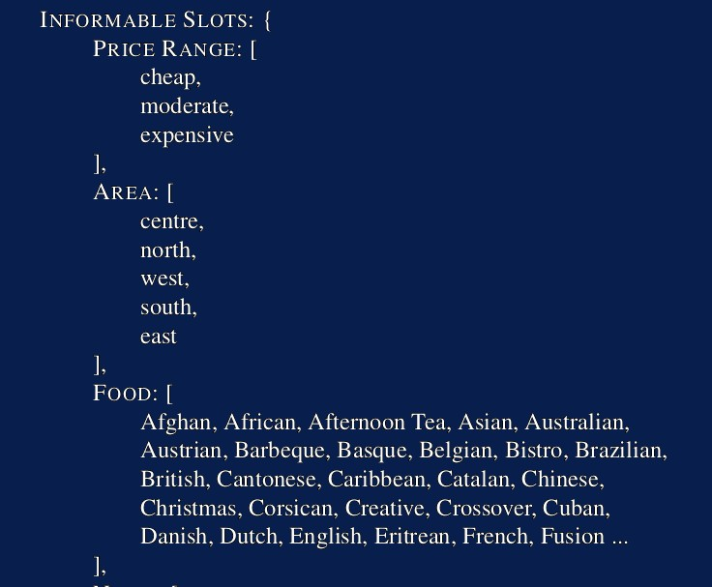
Domain Ontology
A sample from the Cambridge Restaurants domain

Slide 33
Dialogue State Tracking Challenge 2: Evaluation
We focus on two key evaluation metrics [Henderson et al., 2014]:
Goals (joint goal accuracy): the proportion of dialogue turns where all the user’s search goal constraints were correctly identified;
Requests: similarly, the proportion of dialogue turns where user’s requests for information were identified correctly.

Slide 34
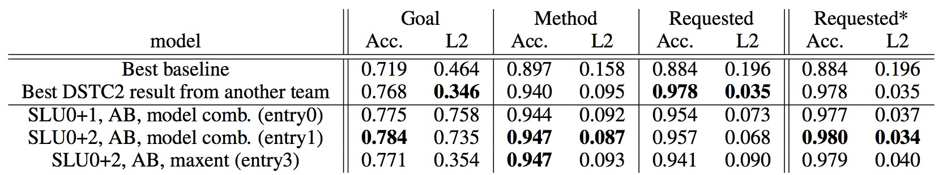
Web-Style Ranking and SLU Combination
[Williams, 2014] uses web-style ranking (lambdaMART algorithm) to rank dialogue states, based on features from three different SLU engines. This was the top entry in the original DSTC2 challenge.

Slide 35
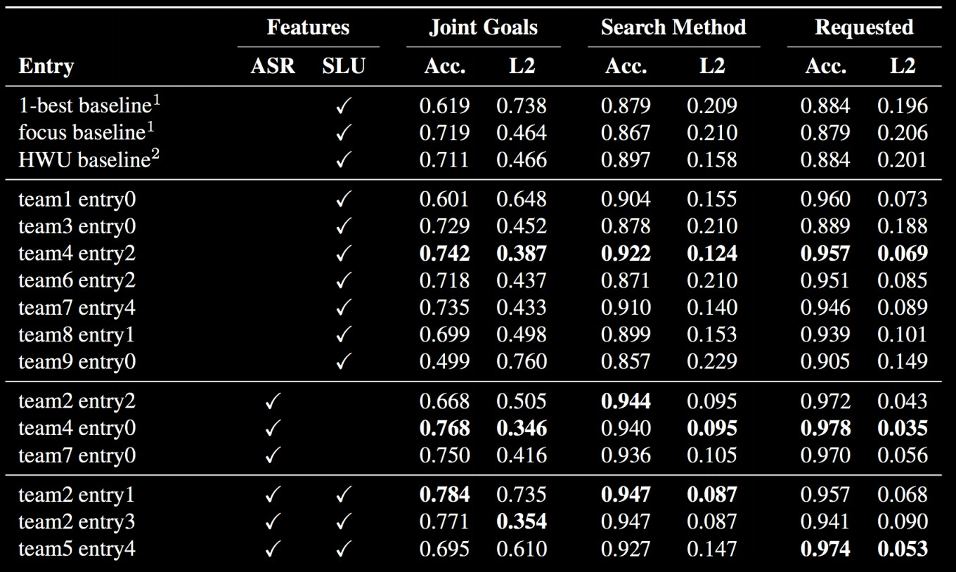
Language Understanding
Joint vs. Separate SLU?

Slide 36
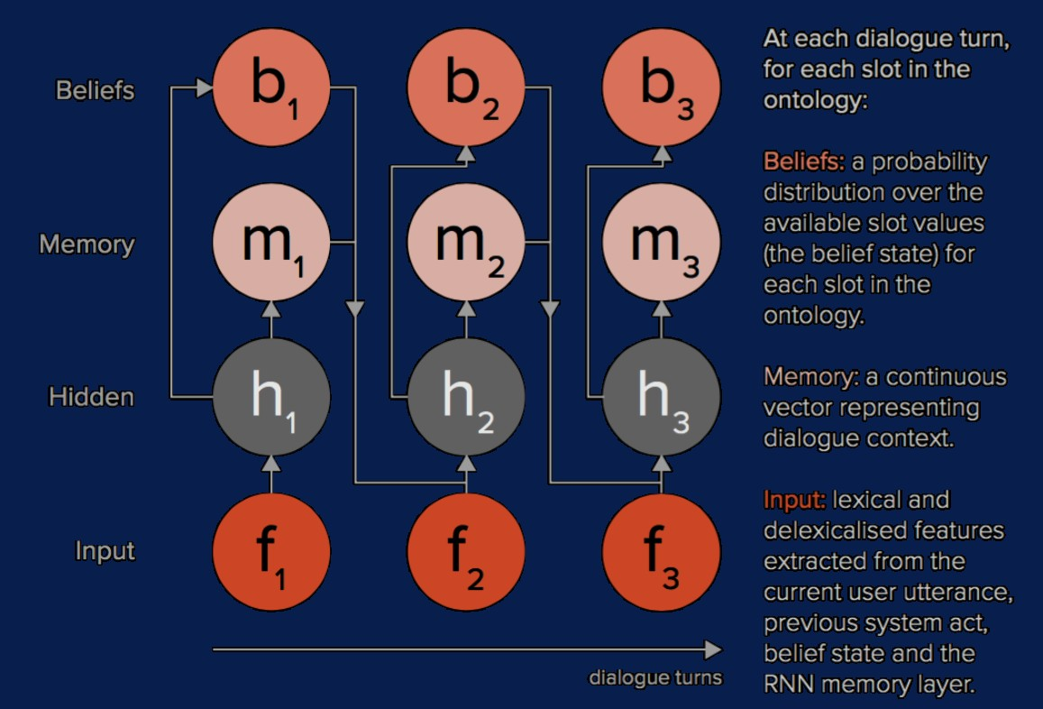
Word-Based DST Using RNNs
[Henderson et al., 2014]

Slide 37

Delexicalisation-Based DST
Delexicalised Features
Delexicalised features: all occurrences of slot names and/or slot values in an utterance are replaced with generic tags
The use of delexicalised n-gram features facilitates:
Faster learning by facilitating transfer learning across slot values
Generalization to unseen slot values (or even entirely new slots)
Bootstrapping dialogue systems to new domains with limited data

Slide 38
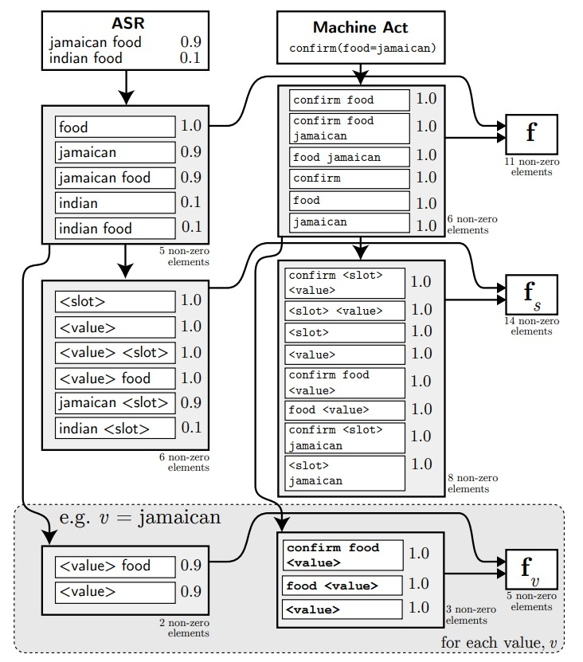
Delexicalisation-Based DST

Slide 39
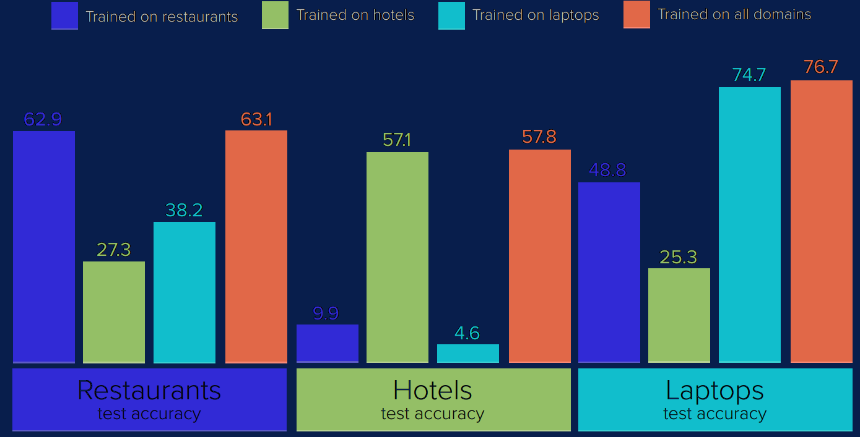
Delexicalisation-Based DST
Towards Multi-Domain DST
Delexicalised features allow transfer learning between slots Delexicalisation facilitates multi-domain training
RNN-based DST with shared initialization + slot-specialized training [Mrksic et al., 2015]

Slide 40
Delexicalisation-Based Models
Shortcomings
Delexicalised Features = Exact Matching
Given an arbitrary domain ontology, delexicalisation-based models provide data-efficient language understanding - as long as users use only the actual ontology values to express their search constraints!
User: I’m looking for an affordable restaurant
inform(price=cheap)
System: How about Thai food?
User: Yes please, in central Cambridge
inform(price=cheap, food=Thai, area=centre)
System: The House serves cheap Thai food
User: Where is it?
inform(price=cheap, food=Thai, area=centre); request(address)
System: The House is at 106 Regent Street

Slide 41
Traditional ‘Solution’: Semantic Dictionaries
Delexicalised Features = Exact Matching
Delexicalisation-based models allow fast deployment to new dialogue domains, but introduce a complete dependency on
semantic dictionaries.
Food=Cheap: [affordable, budget, low-cost, low-priced, inexpensive, cheaper, economic, ...]
Rating=High: [best, high-rated, highly rated, top-rated, cool, chic, popular, trendy, ...]
Area=Centre: [center, downtown, central, city centre, midtown, town centre, ...]

Slide 42
The Neural Belief Tracker (NBT)
Semantic Dictionaries Re-Introduce the SLU module
Semantic dictionaries can be hand-crafted or learned - but only for simple toy domains such as DSTC2. Moreover, the Amazon Mechanical Turk data collection framework forces the users to use very simple (and unnatural) language, understating the challenge of dealing with linguistic variation.

Slide 43
The Neural Belief Tracker (NBT)
Semantic Dictionaries Re-Introduce the SLU module
Semantic dictionaries can be hand-crafted or learned - but only for simple toy domains such as DSTC2. Moreover, the Amazon Mechanical Turk data collection framework forces the users to use very simple (and unnatural) language, understating the challenge of dealing with linguistic variation.
The Neural Belief Tracker is a statistical DST model/framework which aims to satisfy the following design goals:
End-to-end learnable (no SLU modules or semantic dictionaries).
Generalization to unseen slot values.
Capability of leveraging the semantic content of pre-trained word vector spaces without human supervision.

Slide 44
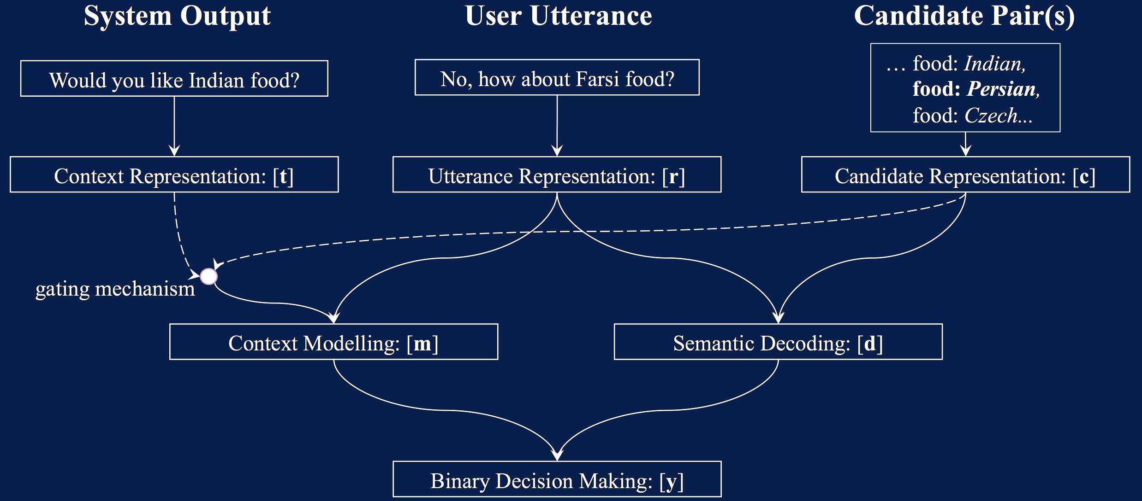
The Neural Belief Tracker (NBT)
Representation Learning + Label Embedding + Separate Binary Decisions
To overcome data sparsity, NBT models use label embedding to decompose multi-class classification into many binary ones.

Slide 45
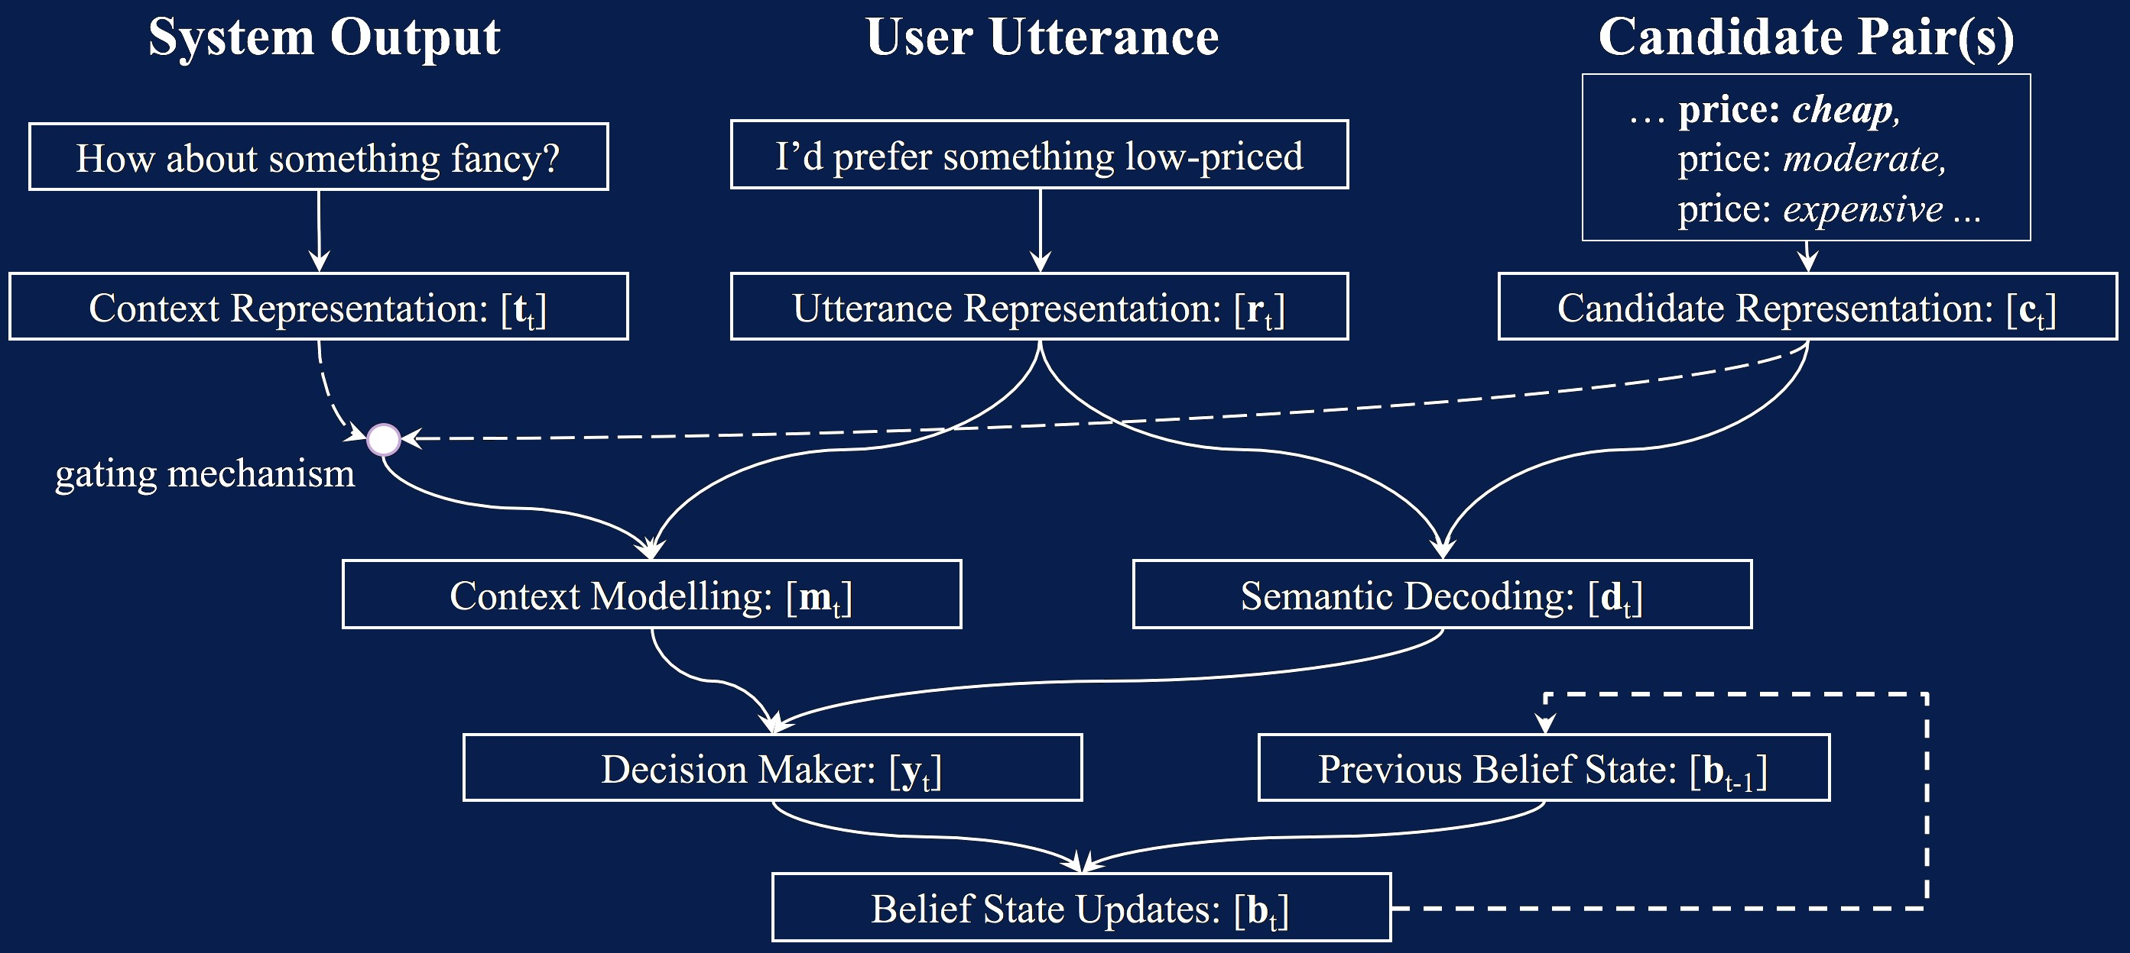
The Neural Belief Tracker (NBT) v2
Fully Statistical Belief State Update
Removing the last rule-based component of the NBT framework

Slide 46
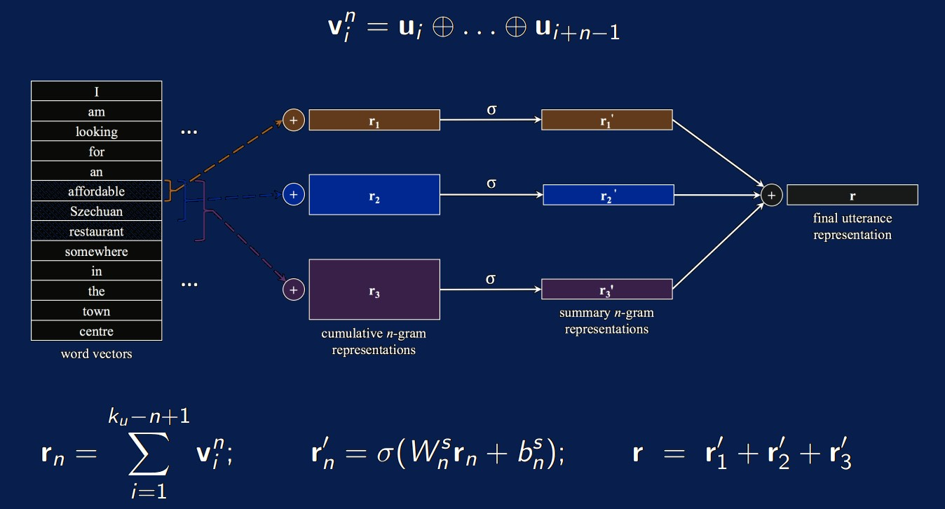
Representation Learning: NBT-DNN
Let u represent a user utterance consisting of ku words u1,u2,.. .,uk_{u} . Each word has an associated fixed word vector u1,.. .,uk_{u}

Slide 47
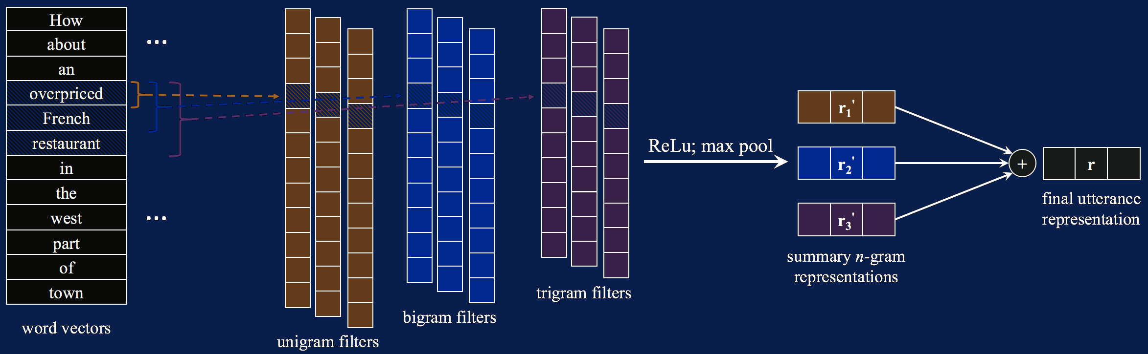
Representation Learning: NBT-CNN

Slide 48
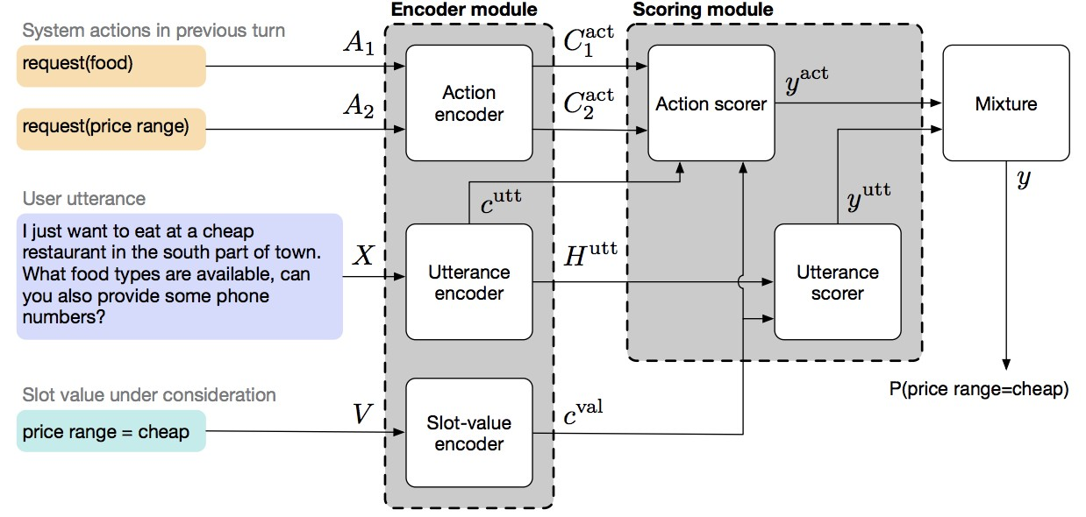
Global-Locally Self-Attentive DST (GLAD)
[Zhong et al., ACL 2018]
The same idea as NBT, but a more advanced encoder
Global modules to share parameters between estimators for each slot and local
modules to learn slot-specific feature representations.

Slide 49
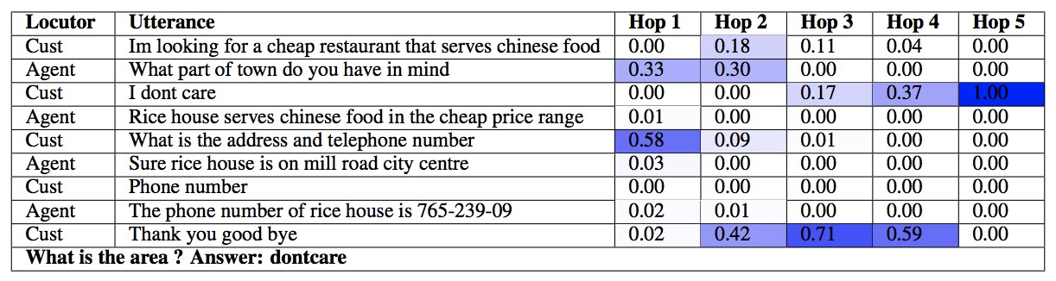
DST as Machine Reading / Reasoning
[Perez and Liu, 2017] use Memory Networks and pose DST as a machine reading / multi-hop reasoning problem.

Slide 50
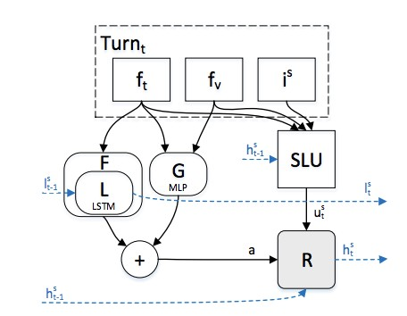
Hybrid Dialog State Tracker with ASR Features
[Vodolán et al., 2017] propose a Hybrid Dialog State Tracker, achieving the current state-of-the-art performance for DSTC2 (0.796).
Their model uses a separate (learned) SLU decoder coupled with a rule-based system to achieve the best DSTC2 performance to date.

Slide 51
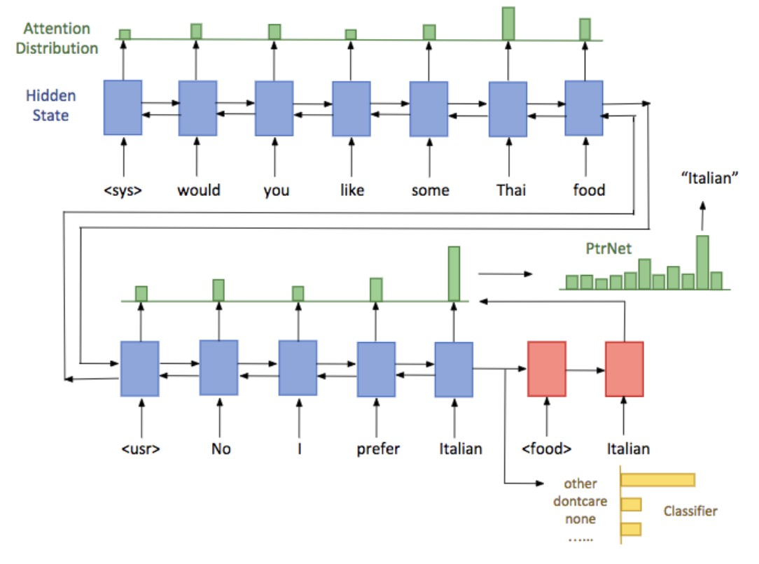
An End-to-end Approach for Handling Unknown Slot Values in Dialogue State Tracking
[Xu and Hu, 2017] use Pointer Networks to address the problem of dealing with unknown, rather than unseen values.
This is an important direction for future work, as most presented models rely on a canonical representation of the domain ontology that is predefined by the dialogue system designers.

Slide 52
Are Word Embeddings Useful for NLU?

Slide 53
Input Word Vectors Matter
Semantic Specialization
It is essential that deployed word vectors are specialized for true semantic similarity [Mrksic et al.; NAACL 2016, TACL 2017]
User: I’m looking for a cheaper restaurant
inform(price=expensive)
System: What kind of food?
User: English, in eastern Cambridge
inform(price=expensive, food=Spanish, area=east)
System: The Green Man is the best choice
User: Where is it?
inform(price=expensive, food=Spanish, area=east);
request(address)
System: The Green Man is at 59 High St, Grantchester

Slide 54
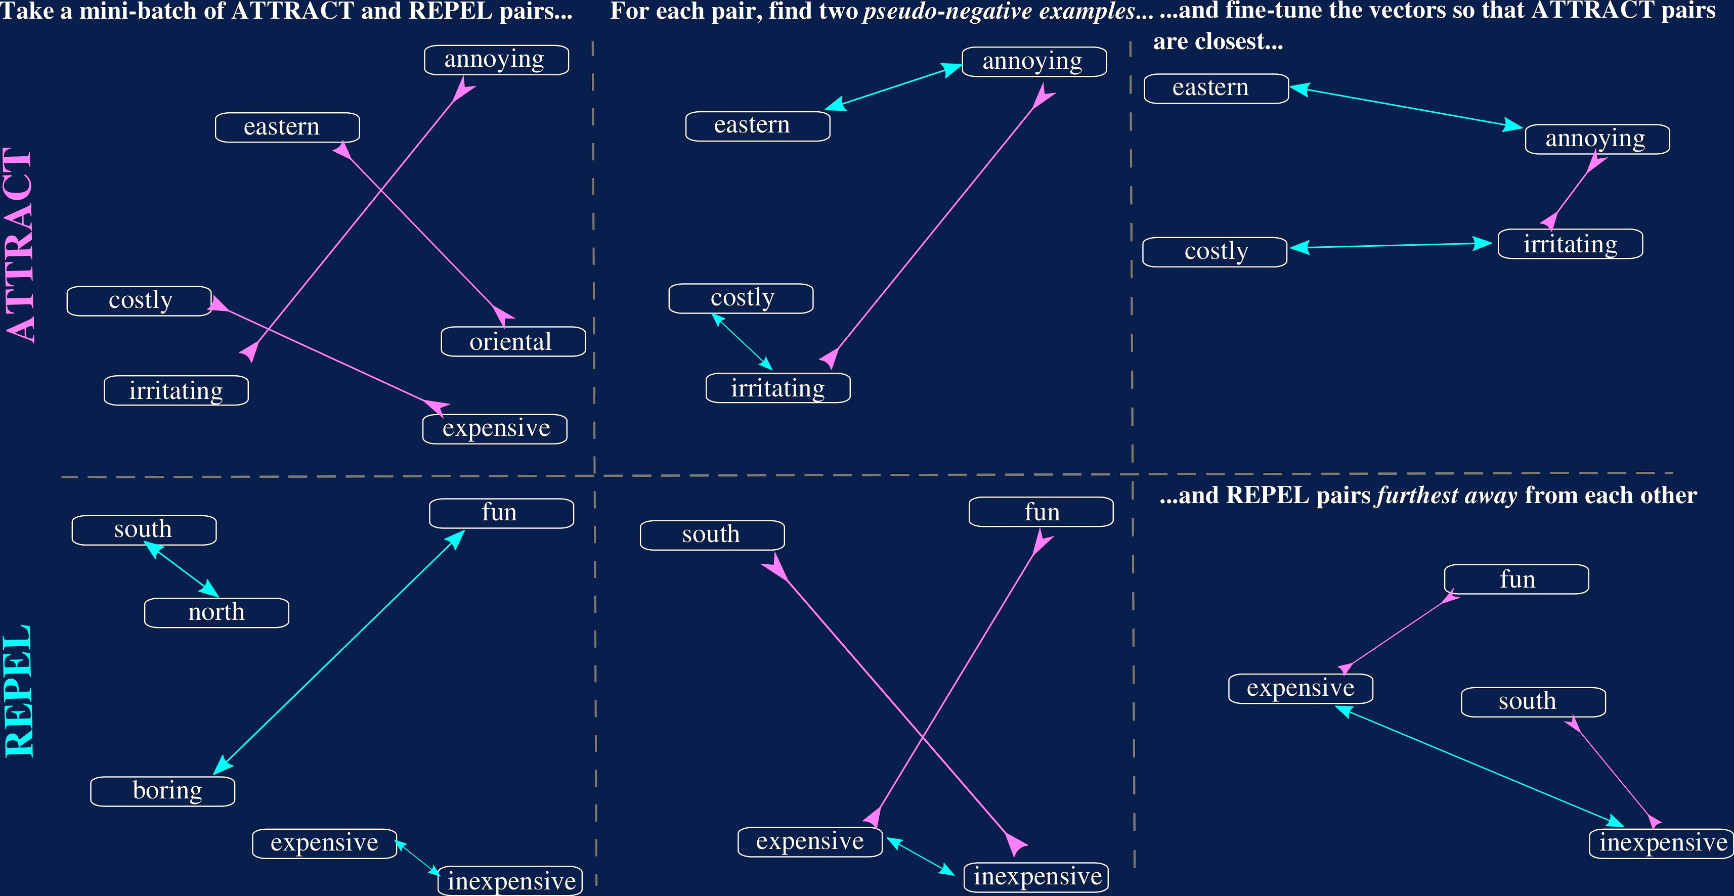
Input Word Vectors Matter
Semantic Specialisation

Slide 55
Semantic Specialisation
Semantically-Specializing Word Vector Spaces
Injecting semantic constraints (such as synonymy and antonymy) into pre-trained word vectors can mitigate some of the negative aspects of the distributional hypothesis.
Word
east
expensive
British
west north south southeast northeast
pricey cheaper costly overpriced inexpensive
American Australian Britain European England
Before
eastward eastern easterly
-
-
costly pricy overpriced pricey afford
Brits London BBC UK
Britain
After
Table: Nearest neighbours before and after semantic specialisation

Slide 56
The Importance of Semantic Specialisation
Three different word vector collections: 1) ‘random’ word vectors initialized using the xavier initialization; 2) distributional GloVe vectors; and 3) semantically specialized Paragram-SL999 vectors.
Word Vectors | DSTC2 Goals Requests |  | WOZ 2.0 Goals Requests
xavier | 64.2 | 81.2 | 81.2 | 90.7
GloVe | 69.0* | 96.4* | 80.1 | 91.4
Paragram-SL999 | 73.4* | 96.5* | 84.2* | 91.6
Recent developments: specialising the full vocabulary yields additional gains
[VuliÊ et al., NAACL 2018, ACL 2018]

Slide 57
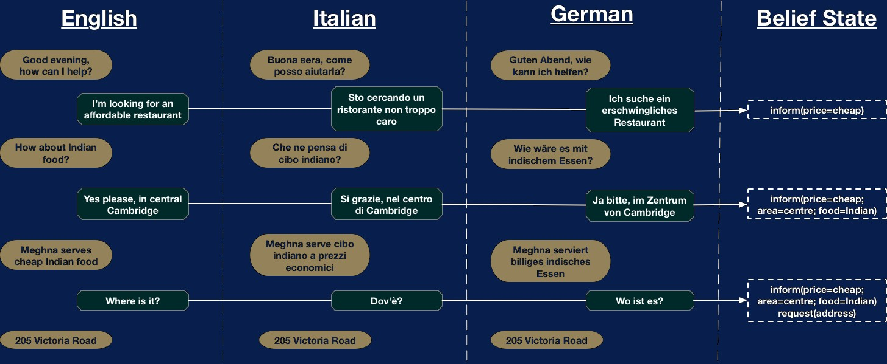
Towards Multilingual DST
We’re still (too) obsessed with English!

Slide 58
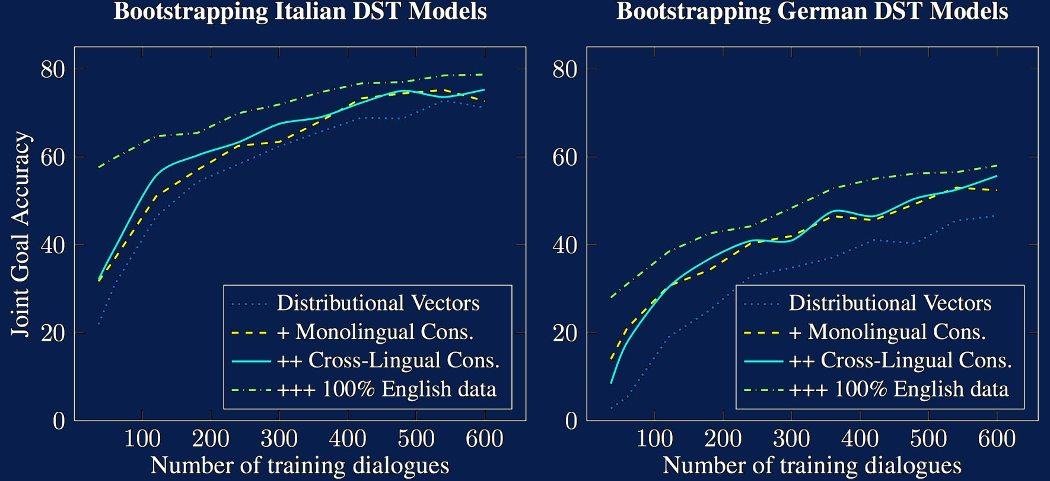
Bootstrapping DST for Resource-Poor Languages
Ontology Grounding: Multilingual DST Models
The concepts expressed in the dialogue domain ontology are language-agnostic: ‘labels’ persist across languages. Given training data for two (or more) languages, and a cross-lingual vector space of high quality, we can train a multilingual DST model. [MrköiÊ, VuliÊ et al., 2017]

Slide 59
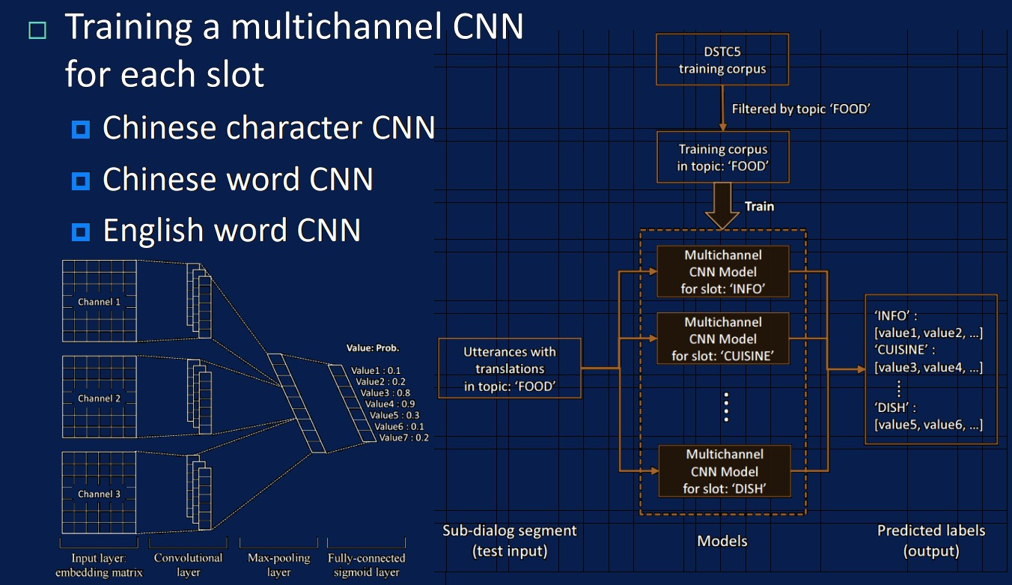
Bootstrapping DST for Resource-Poor Languages
Multichannel DST [Shi et al., 2017]

Slide 60
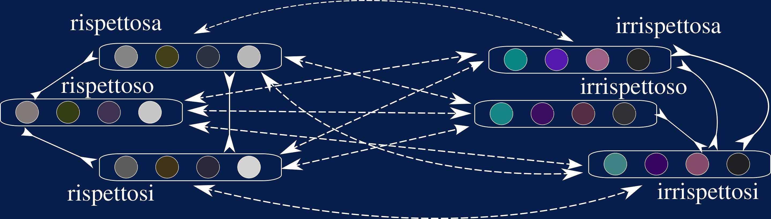
DST Beyond English:
Additional Challenges
Using Different Sources of Supervision
Morphological phenomena provide an inexpensive source of supervision. Consider both inflectional and derivational forms.
[VuliÊ et al., ACL 2017]

Slide 61
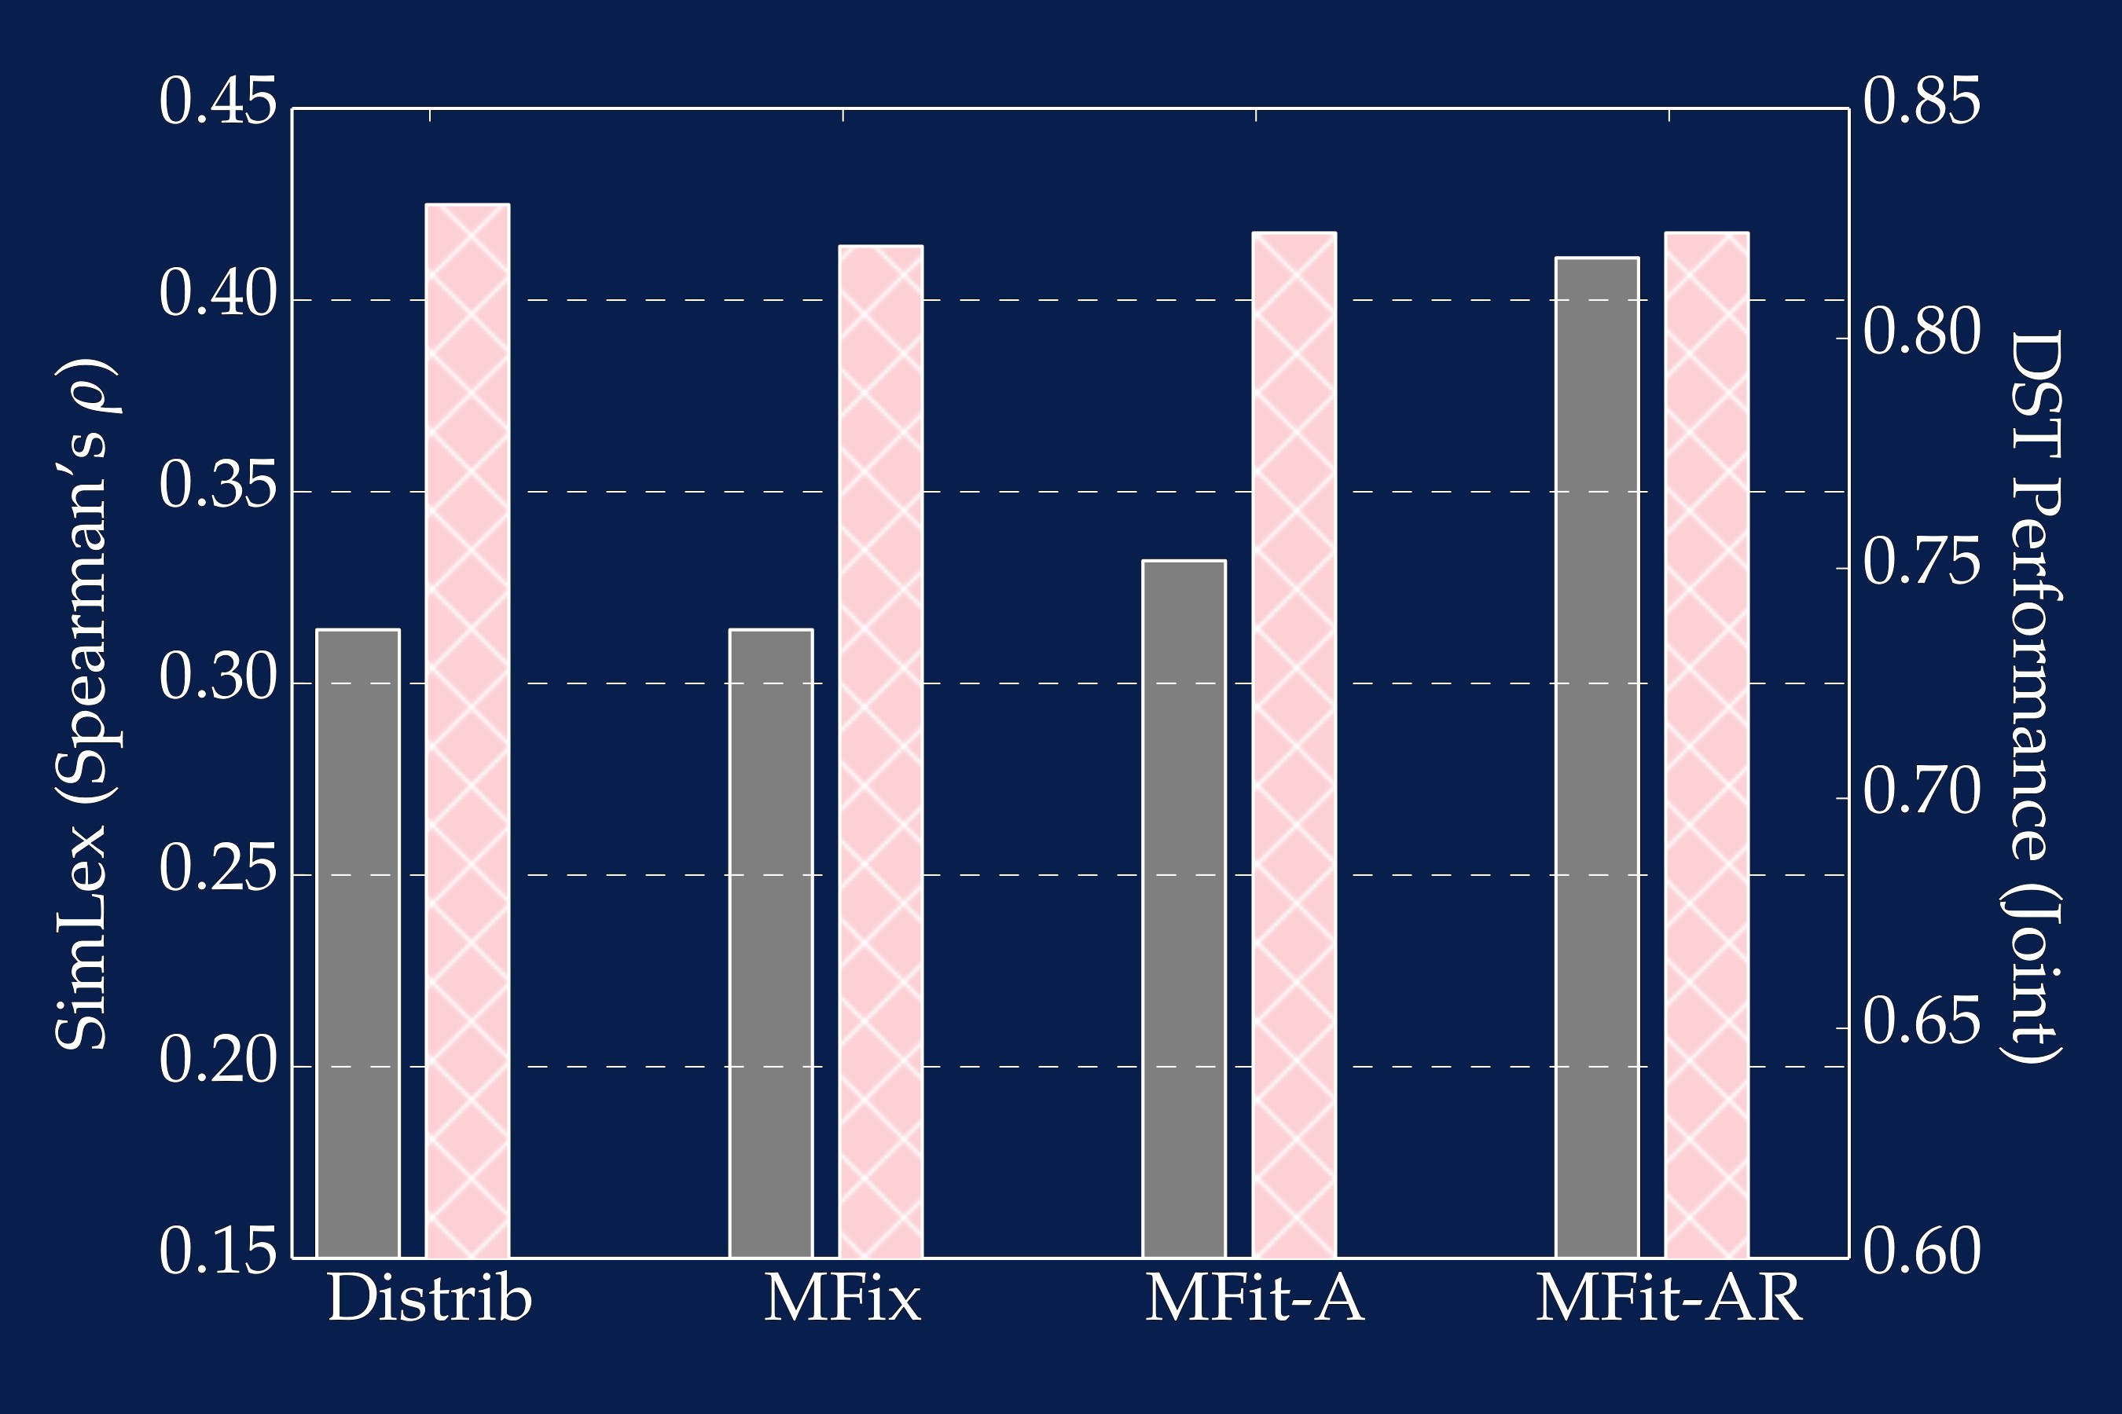
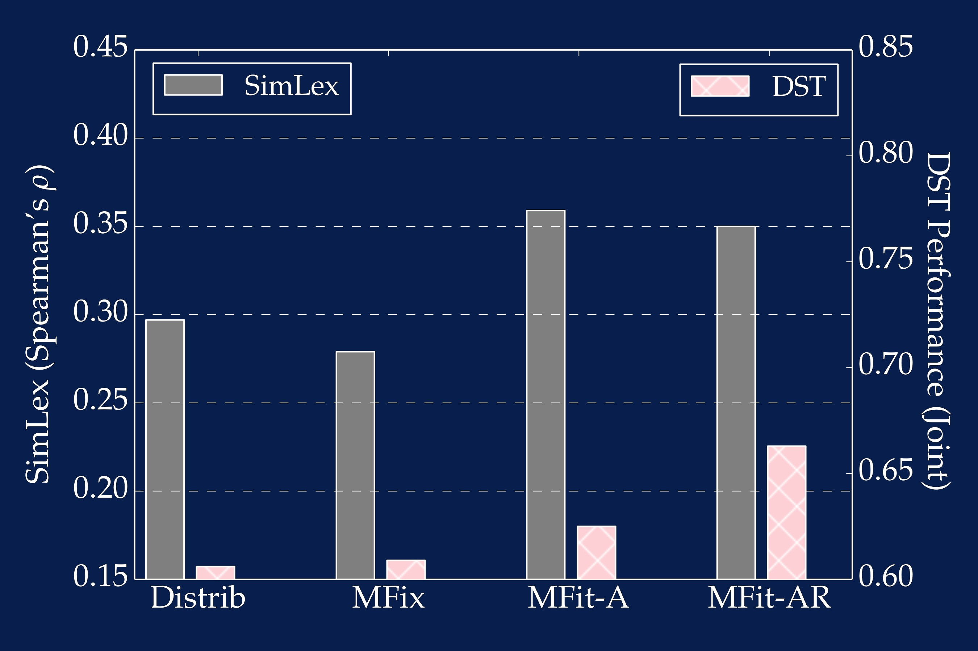
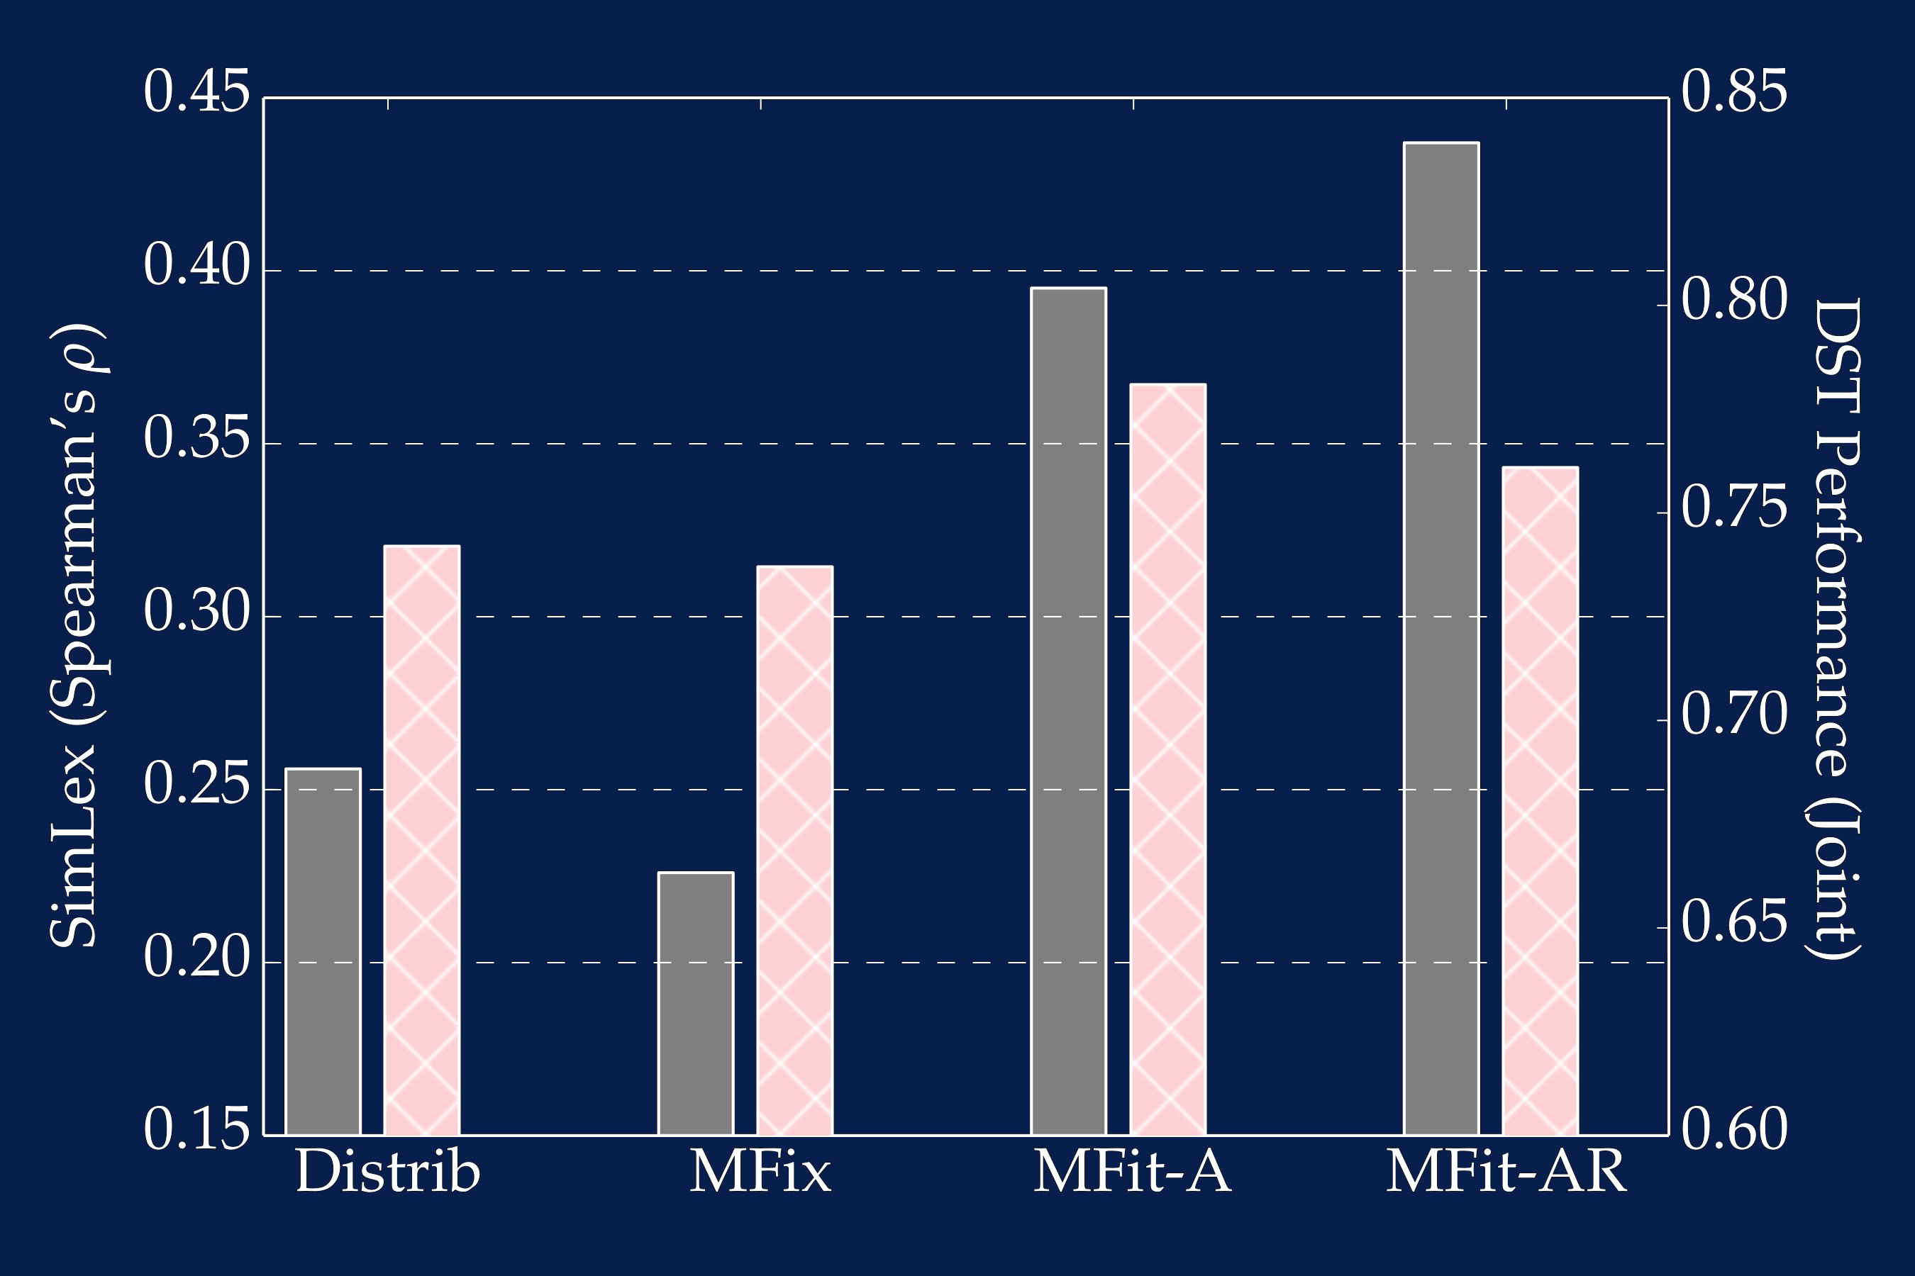
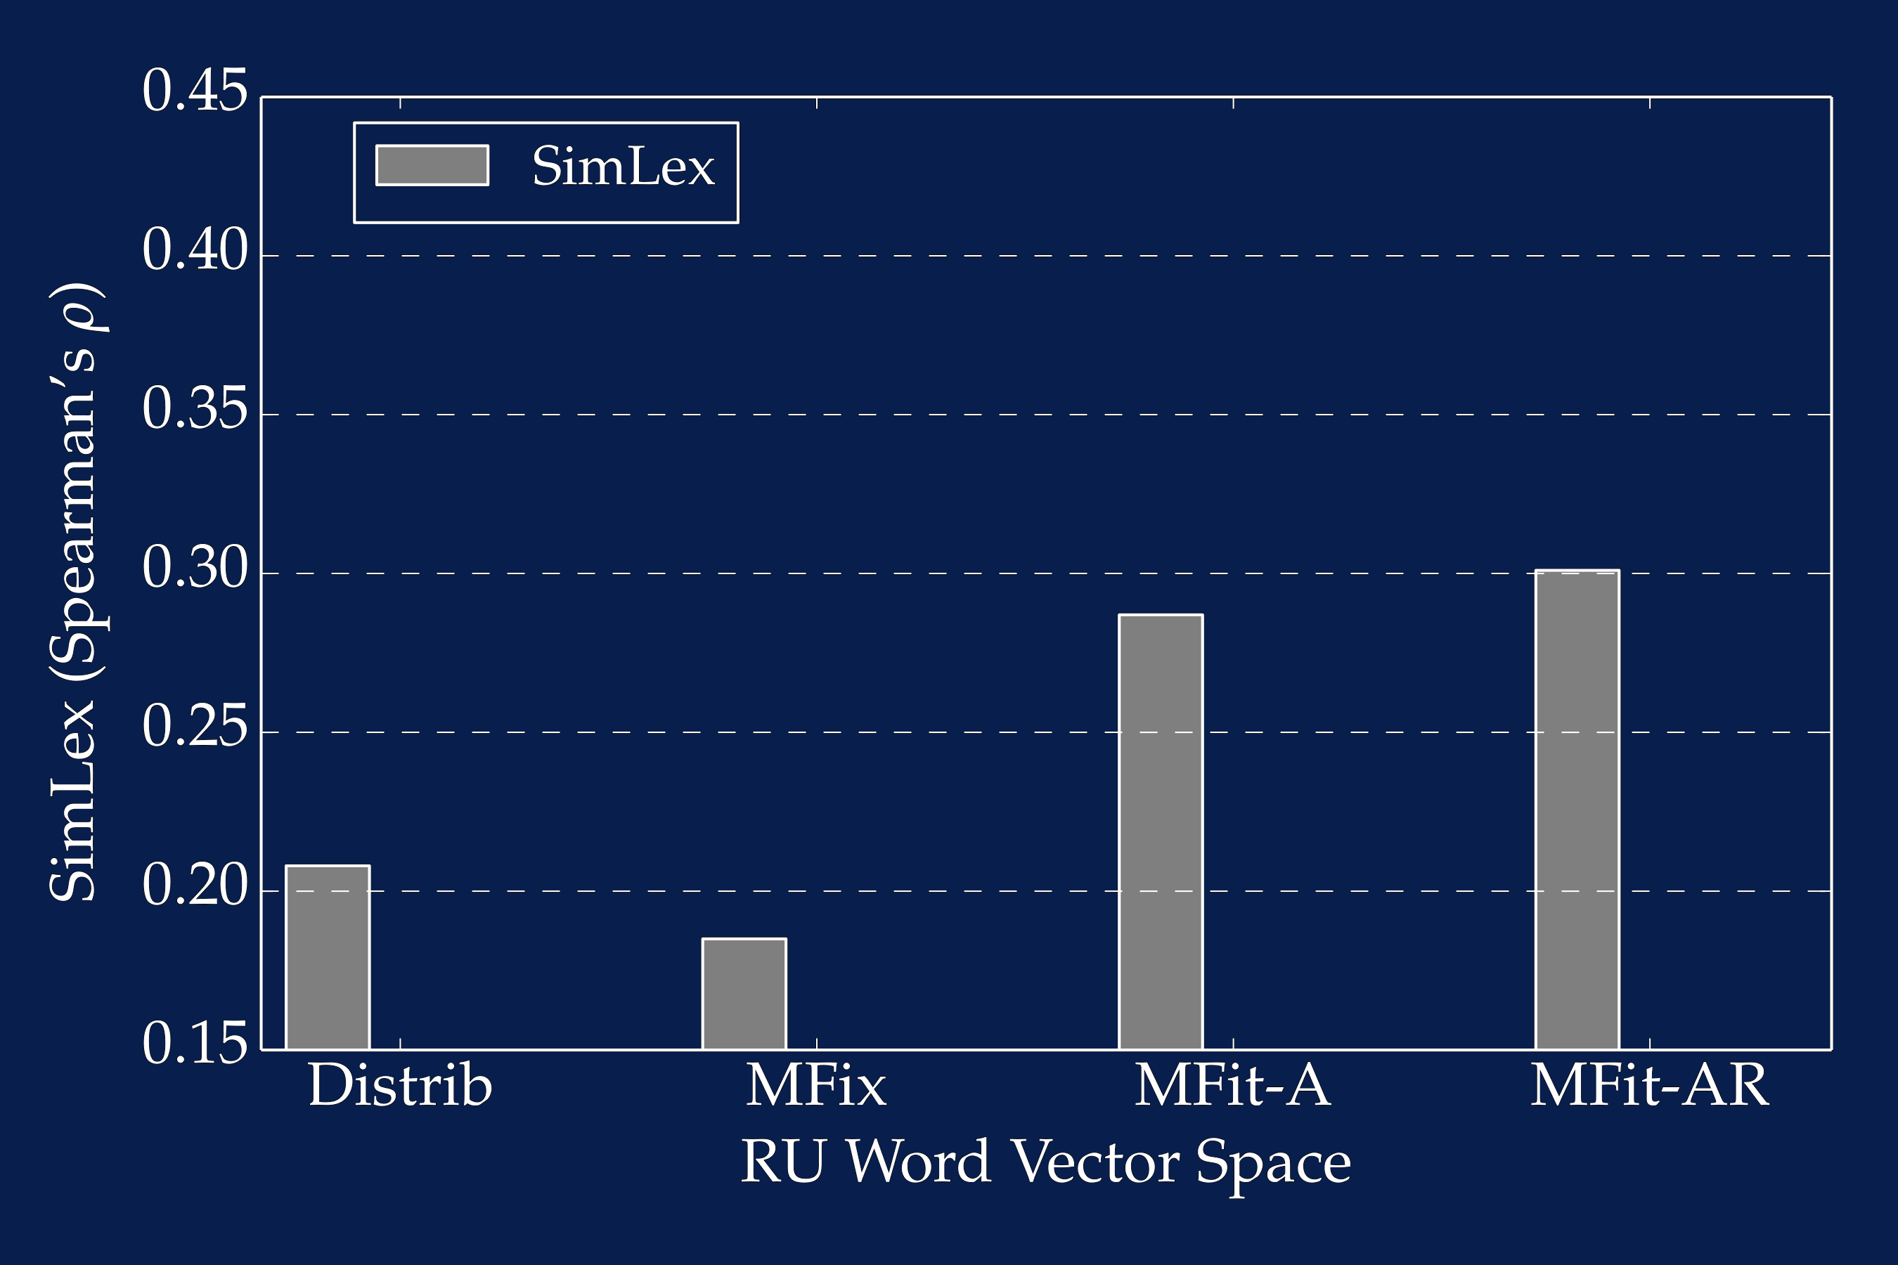
DST Beyond English
with Morph-fitting
(a) English
(b) German
(c) Italian
(d) Russian

Slide 62
Dialogue Management

Slide 63
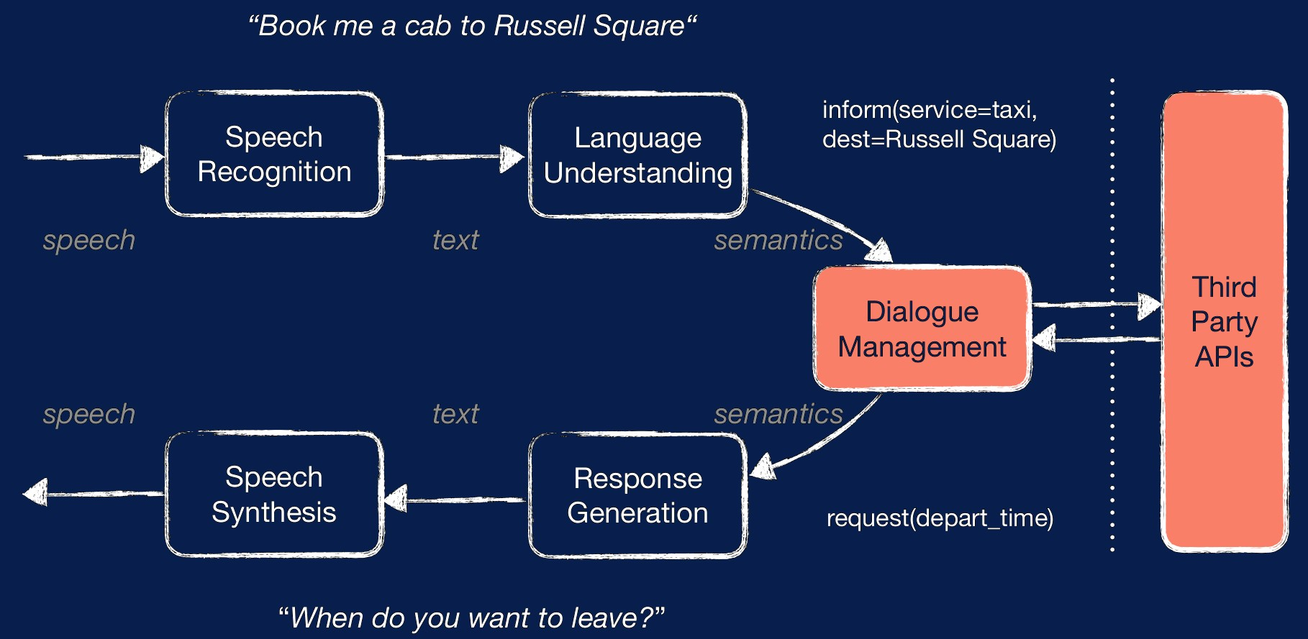
Dialogue Management

Slide 64
Dialogue Management
Approaches
Rule-Based:
Huge hand-crafting effort
Non-adaptable and non-scalable
But this is what works right now
Supervised:
Learn to “mimic” the answers of a corpus
Assumes optimal human behavior
Does not do long-term planning
Reinforcement Learning (RL)

Slide 65
Dialogue Management
Structure-based Approaches
Key phrase reactive
Tree and FSM
…
Principle-based Approaches
Frame
Information-State
Plan
…
Statistical Approaches
Reinforcement Learning

Slide 66
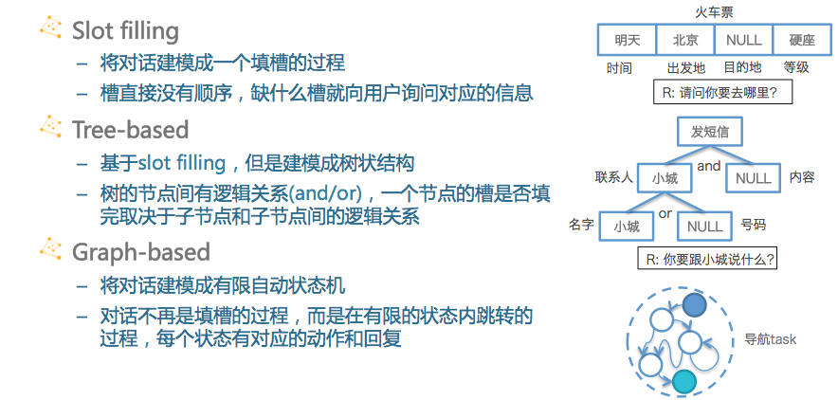
Dialogue Management
Structure-based Approaches

Slide 67
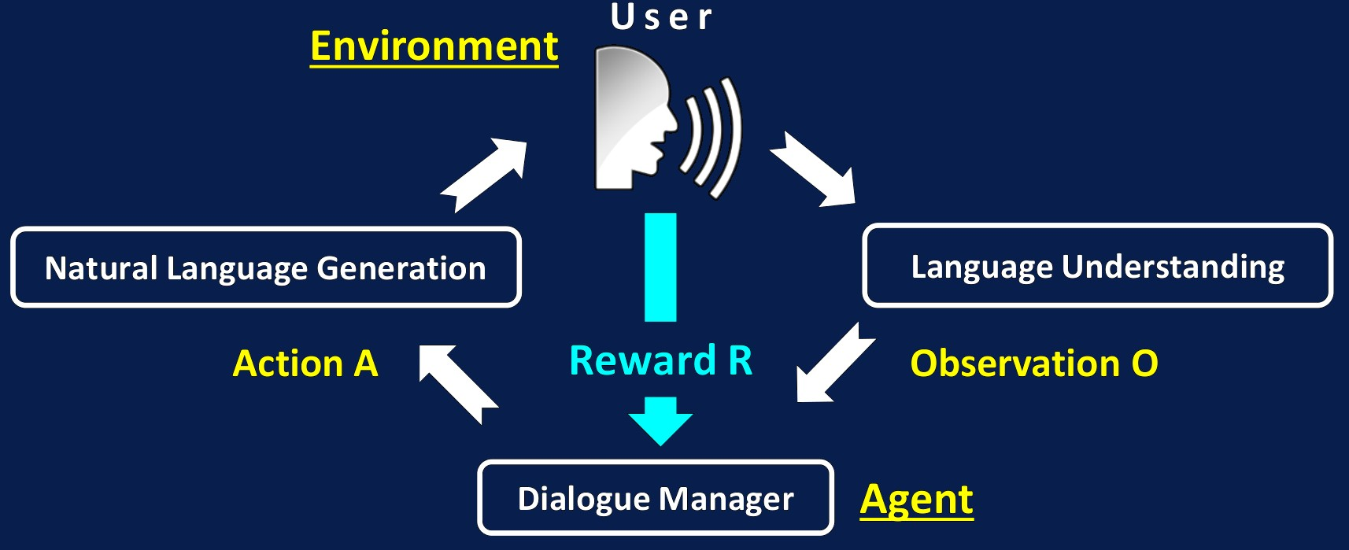
Reinforcement Learning
RL is a general-purpose framework for decision making
RL concerns an agent with the capacity to act
Each action influences the observations obtained from the environment
The agent updates it internal state based on these observations
Success is measured by a reward signal
Goal: select actions to maximize future reward

Slide 68
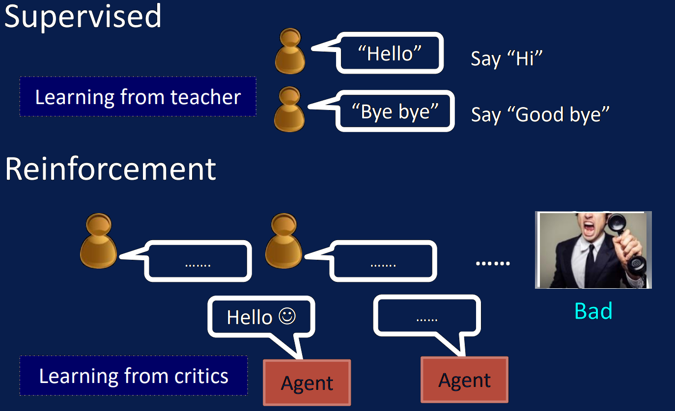
Reinforcement vs Supervised Learning

Slide 69
DM-RL Reward
Reward Design

Slide 70
Dialogue Management
Based on RL
Learns through interaction in order to maximize a future reward
Learns in the actual dialogue environment
Adapts to new environments/users/situations
Requires less annotation
Slow and expensive learning
Difficult to reuse data

Slide 71
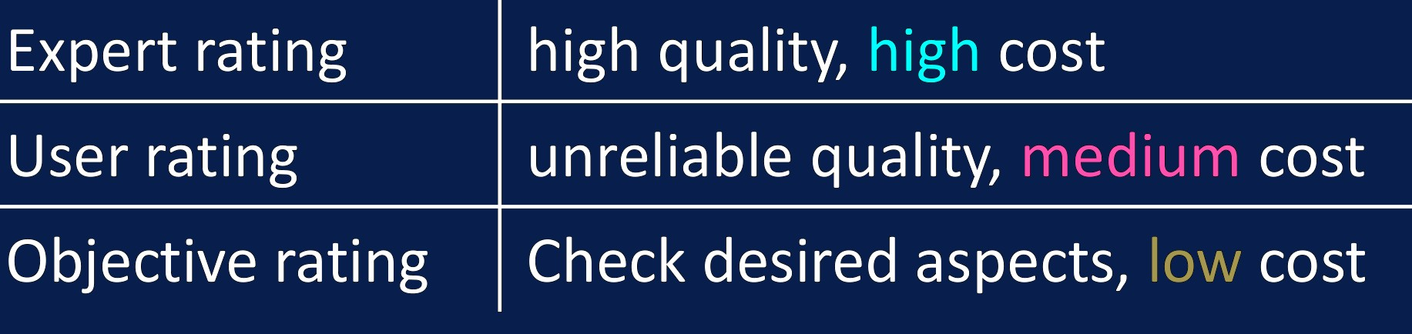
Dialogue Evaluation = Reward for RL
Dialogue is a special RL task
Human is involved in interaction and rating (evaluation) of dialogue
Fully human-in-the-loop framework
Rating: correctness, appropriateness, adequacy

Slide 72
Reinforcement Learning Signal
So what is the reward?
In theory: user satisfaction
In reality: how do we measure the satisfaction?
Ask the user for feedback after each dialogue is very inefficient/annoying
Hand-craft a “user satisfaction” estimator (e.g. success/length trade-off)
→ We usually need to know the user goal to succeed
Train a “user satisfaction” estimator using user feedback → We ask for user feedback only when we are uncertain about it [Su et al., 2016]
In sum: reward modeling is still an open question

Slide 73
Dialogue Management
Evaluation and Reward
How NOT to evaluate your dialogue system [Liu et al., 2017]
There is no standardized metric and no standardized benchmark
Turn-level or dialogue-level evaluation?
Other metrics? BLEU, METEOR, ROUGE? Embedding-based metrics?
Human satisfaction and “objective metrics” do not correlate well
Automatic evaluation metrics can be biased

Slide 74
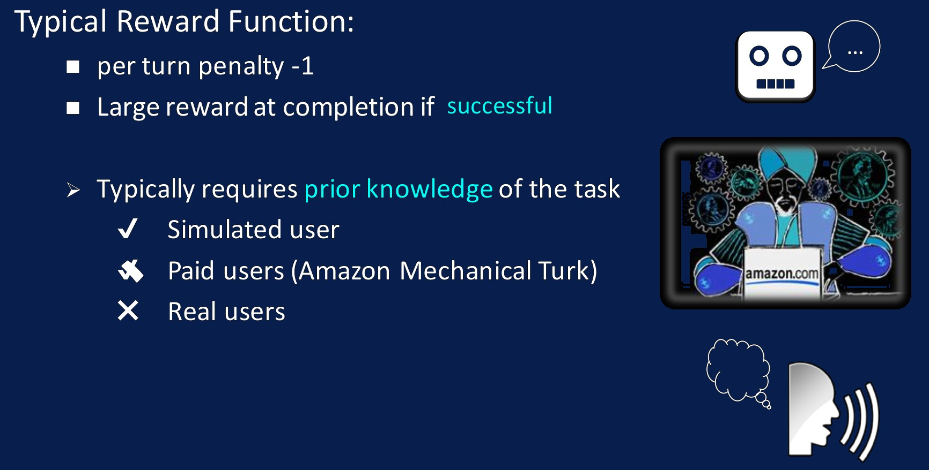
Dialogue Management
Reinforcement Learning Signal in Task Oriented Settings
The user simulator is usually required for dialogue system training before deployment

Slide 75
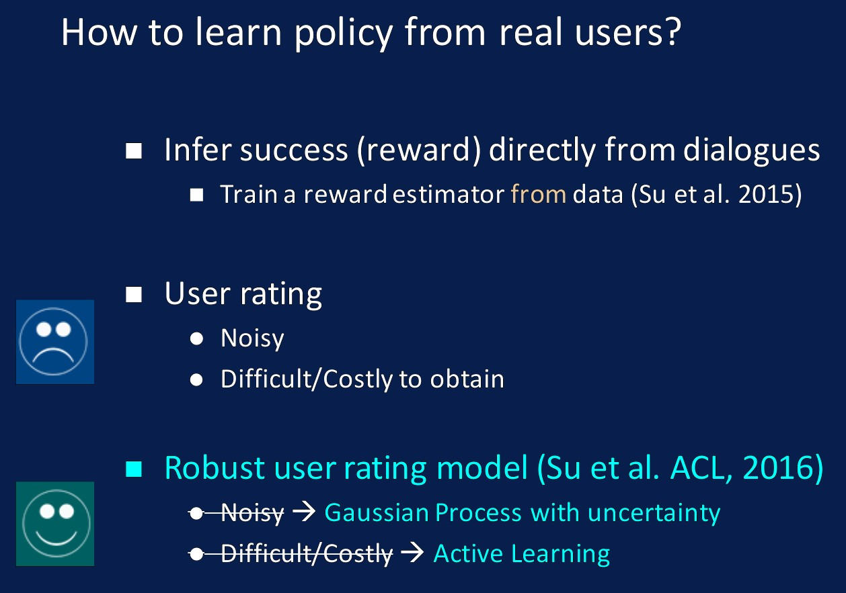
Dialogue Management
Reinforcement Learning Signal

Slide 76
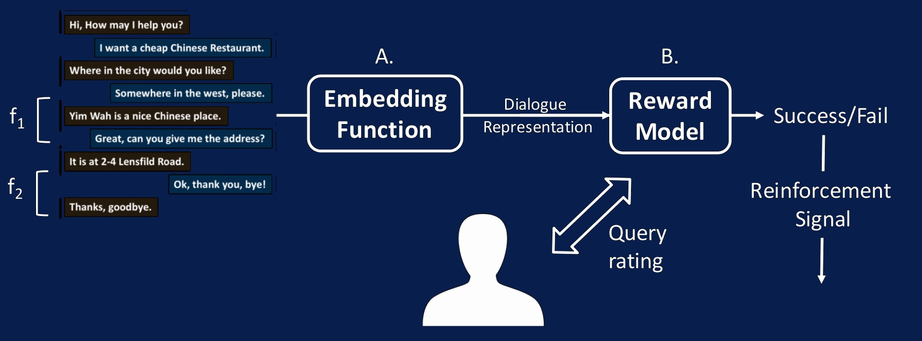
Dialogue Management
Reinforcement Learning Signal
Reward modeling based on users’ binary success rating

Slide 77


Reward Shaping for DM
[El Asri et al., 2014; Su et al., 2015]
Extra reward signal F in addition to environmental reward R, making the system learn from the composite signal R + F
Turn-level rewards via RNNs

Slide 78

RL-Based DM: Quick Recap
Continuous state Markov Decision Process (MDP) composed by:
Multivariate belief state space B
Finite set of (discrete) actions A
Reward function R(b, a)= r_{t} where a $∈$ A, b $∈$ B
One of the critical challenges: sample-efficiency
Solutions: Sample-efficient actor-critic
Off-policy learning with experience replay
Better Gradient Update

Slide 79

Sample efficient RL
Experience Replay (ACER, TRACER, eNACER)
Make efficient use of past data
[Su et al., 2017; Wang et al., 2017; Weisz et al., 2018]

Slide 80
DM-RL Training
User Simulation

Slide 81
Dialogue Management
Training Approaches
Supervised Learning (SL)
Wizard-of-Oz (WoZ) methods to collect (high-quality?) data
Easy to get to reasonable performance
No planning, not optimal in deploying environments
Low coverage
Reinforcement Learning (RL)
Learn policy online with real or simulated users
Poor performance in early training stages
Combine the best of both worlds using one single model
[Rieser and Lemon, 2016; Henderson, 2008; Fatemi, 2016; Zhao, 2016; Williams, 2017]

Slide 82

Sample-Efficient RL + Supervised Data
Some Empirical Results
[Su et al., 2017]

Slide 83
User Simulation
Why don’t use a corpus?
Different policy ← different trajectories: Corpus based evaluation is not possible
Corpus coverage biased / not wide enough
Replace the real user in the pipeline by a model that replicates the user behavior
Cheap / reusable method to train (and test) statistical dialogue systems
Useful for research, hyperparameter tuning, etc.
Necessary evil

Slide 84
Different simulation approaches
Model:
Rule-based: Manually crafted by experts (synthetic data) [Schatzman et al., 2007; Keizer et al., 2010]
Learning-based: Trained from a corpus of dialogues (data augmentation) [Pietquin and Dutoit,2006; El Asri et al., 2016; Crook and Martin, 2017]
Output level:
Semantic level (dialogue act)
Text level (natural language)
Error simulation:
No error
Language understanding error [Schatzman et al., 2007; Thomson et al., 2010]
ASR error [Pietquin et al., 2002]

Slide 85

Training with User Simulator

Slide 86
User Simulation (Rule-Based)
Trained experts construct and fine-tune the simulation process
Pros:
No data needed
Full control of user behavior
Cons:
Very costly
Not enough coverage / variability

Slide 87

Agenda-Based user simulation
[Schatzman et al., 2007; Keizer et al., 2010]

Slide 88
User Simulation (Model/Learning-Based)
Transform a static corpus of dialogues into a dynamic tool
Previously:
bigram models [Eckert et al., 1997; Levin et al., 2000]
graph-based [Scheffler and Young, 2000]
HMMs [Georgila et al., 2005; Cuayahuitl et al., 2005]
...
Today: neural models
Seq2Seq user simulation [El Asri et al., 2016; Crook and Marin, 2017; Kreyssig et al. 2018]

Slide 89

Seq2Seq User Simulation
Input: c_{i} encodes contextual features (e.g., previous system action, consistency between user goals and system-provided values)
Output: a dialogue act sequence from the user
[El Asri et al., 2016]

Slide 90

Seq2Seq User Simulation
[Crook and Marin, 2017]
Text based simulation
No labeled data
Trained on human-to-machine conversations

Slide 91

Seq2Seq User Simulation
[Kreyssig et al. 2018]
Input: Contextual features
Output: Natural language
User goal and goal changes explicitly modelled → Can be used to train a RL-based policy

Slide 92
Evaluating User Simulation
Direct methods
Measure the similarity between the outputs of the simulator and a real user in a test set
Simulators trained on the same or similar metrics
Variability is penalized, even if its consistent
Indirect methods
Cross-model evaluation
Training with simulated user / evaluating with real users

Slide 93

Indirect evaluation
[ Kreyssig et al. 2018]
RL policy trained with simulated user and tested with real users
Systems trained with a (good) simulated user
perform well with real users
System performance evaluation using simulated users correlates with performance evaluation with real users

Slide 94
Battling Data Inefficiency
More structure → Less data needed
Summary actions
Action masks
Hierarchical structures

Slide 95
Natural Language Generation

Slide 96

Natural Language Generation

Slide 97
Natural Language Generation
Problem Definition
“NLG is the process of deliberately constructing a natural language text in order to meet specified communicate goals.”
[McDonald, 1992]
Input: a communicative goal. E.g. non-linguistic representation of information
Output: natural language utterance (combined with graphics, tables, etc)
Knowledge Required: intended communication scope, domain knowledge, the actual language

Slide 98

Natural Language Generation
Problem Definition
Meaning representation → natural language utterances
What do we care about? - naturalness and variation
Other applications - summarisation, short-text report

Slide 99
NLG Evaluation
Subjective: human judgement [Stent et al., 2005]
Adequacy: correct meaning
Fluency: linguistic fluency/naturalness
Readability: fluency in the dialogue context
Variation: multiple realisations of the same meaning
Objective: automatic evaluation measures
Word overlap: BLEU, METEOR, ROUGE
Embedding-based: greedy matching, embedding average
Task-oriented: item error rate
Big gap and anti-correlation between human judgements and automatic measures

Slide 100

NLG Evaluation
The gap between human perception and automatic metrics [Stent, 2005; Liu et al., 2017; Sharma et al., 2017]
Real user trial is still the best way to evaluate NLG
...but it is inefficient and suffer from inter/intra-rating mismatch

Slide 101

Template-Based NLG
Define a set of rules to map meaning representation (i.e., frames) to natural language
Pros: simple, error-free, easy to control
Cons: time-consuming, poor scalability, repetitive

Slide 102
Pipeline approach to NLG
What to say?
Content planning: pick contents and order them
Dialogue policy handles this in SDS
How to say it?
Sentence planning: get sentence (tree), put content in right places, lexicalization, etc.
Surface realization: creates linear text and ensures its grammar

Slide 103

The "how to say it" Pipeline in NLG
[Walker et al., 2002]
Sentence planning + Surface realisation

Slide 104
Statistical approaches to pipelined NLG
Statistical sentence plan generator [Stent et al., 2009]
Statistical surface realizer
[Dethlefs et al., 2013; Cuayahuitl et al., 2014]
Learning from unaligned data [Duöek and Jurcicek, 2015]
Pros: can model complex linguistic structures
Cons: heavily engineered, require extensive domain knowledge

Slide 105

RNN-Based LM NLG
[Wen et al., 2015]
“Deep” revolution has also transformed NLG
Distributed representations: Generalisation
Recurrent connections: Long-term dependencies
Conditional RNNs: Flexibility and creativity
Attention mechanism: Focus on relevant and meaningful parts

Slide 106
RNN-Based LM NLG
Handling Semantic Repetition/Missing
Empirically, semantic repetition is observed
“EAT is a great British restaurant that serves British food.”
“EAT is a pet-friendly place in the cheap price range. It is affordable and also allows pets.
How to mitigate this problem?
Post-processing rules
Gating mechanism
[Oh and Rudnicky, 2000] [Wen et al., 2015]
Attention
[Mei et al., 2016; Wen et al., 2016; Tran and Nguyen, 2017]

Slide 107

RNN-Based NLG
Learning to Control Gates
Learn to open/close the LSTM gates based on generation history [Wen et al., 2015]

Slide 108

RNN-Based NLG
Feature Visualisation

Slide 109

(Attentive) Seq2Seq for NLG
Encode Dialogue Act, Seq2Seq for generation [ Duöek and Jurcicek, 2016, Wen et al., 2015; ...]

Slide 110

Recent Work in Neural NLG
Re-using info from the input directly: CopyNet and PointerNet [Gu et al., 2016; Gulcehre et al., 2016; Cao et al., 2016; He et al., 2016; Miao et al., 2016; Ling et al., 2017 ...]

Slide 111

Recent Work in Neural NLG
Retrieval-based NLG: select from a set of predefined responses [Lowe et al., 2015; Yan et al., 2016; Wu et al., 2017]

Slide 112

Recent Work in Neural NLG
Combining retrieval-based and generative NLG [Song et al., 2016]

Slide 113

Recent Work in Neural NLG
Generating Sentences by Editing Prototypes [Guu et al., 2017]

Slide 114
Recent Work in Neural NLG
Controlled text generation based on VAE/GANs [Wen et al., 2017; Li et al., 2017; Hu et al., 2017, Subramanian et al., 2017; Fedus et al., 2018]
Slot-value informed Seq2Seq models [Sharma et al., 2017; Nayak et al., 2017]
Check also a recent survey paper on NLG focused on more traditional approaches [Gatt and Krahmer, 2018]

Slide 115

Learning Objective for NLG
Closely related to the NLG evaulation
Maximising the log-likelihood only optimises the perplexity.
Other approaches
Discriminative Training [Wen et al., 2016]
Separating correct examples from competing incorrect ones
Reinforcement Learning [Li et al., 2016]
Additional info as reward: Mutual Information, Semantic Coherence, Information Flow...

Slide 116
Corpus and Data for NLG
Statistical models are reflecting what’s in the data
Data quality decides the quality of the NLG system
Do not learn from templates or synthetic data - you are just reverse engineering the design
Collect your own real user data! [Wen et al., 2016; Shah et al., 2018; ...]

Slide 117
Short Summary on NLG
Evaluating NLG is hard. The best way is human evaluation
In product, template-based NLG is still most common
Learning-based NLG (+ linguistic knowledge) are promising, but be careful of the objective and data
NN-based NLG is a conditional neural LM that learns
realisation and semantic alignments jointly
Recent trends: adversarial modeling, E2E learning

Slide 118
End to End Dialogue Modelling

Slide 119

End to End Dialogue Modelling
Why end to end?

Slide 120

End to End Dialogue Modelling
Why end to end?

Slide 121

Sequence-to-Sequence Conversational Model
Social Chatbots (Chit-chat dialogue systems)
[Vinyals et Le, 2015]

Slide 122

Hierarchical RNN for Dialogue
Problems: Generic, diffculty keeping coherence, lack of integration into KBs or 3rd party services... not very useful for business use cases (task oriented dialogues)

Slide 123

Task Oriented End-to-End Dialogue Modelling
Joint NLU and Policy Learning
No need to define / annotate belief states [Zhao and Eskenazi, 2016]

Slide 124

Task Oriented End-to-End Dialogue Modelling
Joint Policy and NLG Learning
No need to define / annotate dialogue acts [Wen et al, 2017]

Slide 125

Task Oriented End-to-End Dialogue Modelling
Joint Policy and DB query learning
No need to define DB query heuristics [Dhingra et al., 2017]

Slide 126

Task Oriented End-to-End Dialogue Modelling
Memory Networks for Dialogue Modeling
more related work [Liu and Perez, 2016; Eric and Manning, 2017; Seo et al., 2016]

Slide 127
Where are we in End-to-End Dialogue Modelling?
Most E2E approaches are presented in very simple domains and non-reproducible environments: the problems adapted to the model and not vice versa
bAbI dialogue tasks (and parlAI) & DSTC6 will make E2E dialogue research more reproducible
Generative E2E dialogue modelling is extremely hard to get it work, and still seems far from real world applications. But what about discriminative models?

Slide 128

A Working-Example: Google Smart Reply

Slide 129
Trends, Challenges, Future

Slide 130

Cooperative Visual Dialog using DRL
[Das et al., 2016, 2017]

Slide 131

Knowledge-Grounded Conversational AI
[Ghazvininejad et al., 2017]

Slide 132


Multi-Modal Conversational AI
Intent Understanding from the Visual Context?
Proactive behaviour: understand user intents to initiate the dialogues

Slide 133

Multi-Modal Conversational AI
Emotion Recognition and Empathy?
Integrate an emotion recognition and empathy module
Multi-modal emotion recognition
Emotion-aware response generation

Slide 134

(The Art of) Negotiation Dialogue
[Lewis et al., 2017; Keizer et al., 2017]
Both linguistic and reasoning problem
Negotiations are hard and awkward, incentive to withhold information
There is no simple solution, but easy to evaluate

Slide 135

Alexa Skills Challenge
Adding new abilities to Amazon Alexa
An augmented reality virtual pet
The dealer in poker
Trip planner based on FourSquare, Google Places info
Full voice control over Chrome browser
Tweeting using voice
Live ice hockey updates...

Slide 136

Industry Landscape

Slide 137

Current Industry Practice: Flowcharts

Slide 138

A Brief Summary of Conversational AI Approaches

Slide 139

Conclusion
A collective effort!

Slide 140
Conclusion
Conversational AI is a collective effort of multiple parties and requires a mix of multiple methods
Machine Learning is...
a perfect tool for language understanding
an OK method for response selection/generation
currently not a way to go for dialogue decision-making and database integration (we need more and more high-quality data)
Being practical but open-minded in choosing approaches is the way to build robust and truly useful conversational AI of the future

Slide 141

A Not-So-Far-Away Future

Slide 142
Useful Software I
PyDial: open-source toolkit with implementations of statistical approaches for all dialogue system modules
http://dialogue.mi.eng.cam.ac.uk/index.php/pydial/
ParlAI: “A unified platform for sharing, training, and evaluating dialog models across many tasks”
http://parl.ai/
DeepPavlov: another open-source conversational AI library
https://github.com/deepmipt/DeepPavlov
NBT: Implementation of the fully statistical NBT DST model
https://github.com/nmrksic/neural-belief-tracker
Different DST Models available on GitHub
https://github.com/CallumMain/DNN-DST
https://github.com/voicy-ai/DialogStateTracking

Slide 143
Useful Software II
NNDial: end-to-end trainable task-based systems
https://github.com/shawnwun/NNDIAL
RNNLG: NLG using RNNs
https://github.com/shawnwun/RNNLG
Neural Dialogue Generation: implementations of NLG methods from the Stanford NLP Group
https://github.com/jiweil/Neural-Dialogue-Generation
Other open-source NLG software
https://github.com/simplenlg/simplenlg
http://www.fb10.uni-bremen.de/anglistik/langpro/kpml/README.html http://nlp.cs.aueb.gr/software.html

Slide 144
Useful Software III
Deep RL: a simple deep RL dialogue system
https://github.com/cuayahuitl/SimpleDS
Attract-Repel: tool for word vector space specialization
https://github.com/nmrksic/attract-repel
DSTC: data and scripts from the latest campaigns
https://github.com/oplatek/sds-tracker
https://github.com/hkhpub/dstc4
https://github.com/seokhwankim/dstc5
https://github.com/perezjln/dstc6-goal-oriented-end-to-end
https://github.com/dialogtekgeek/DSTC6-End-to-End-Conversation-Modeling

